Slide 1
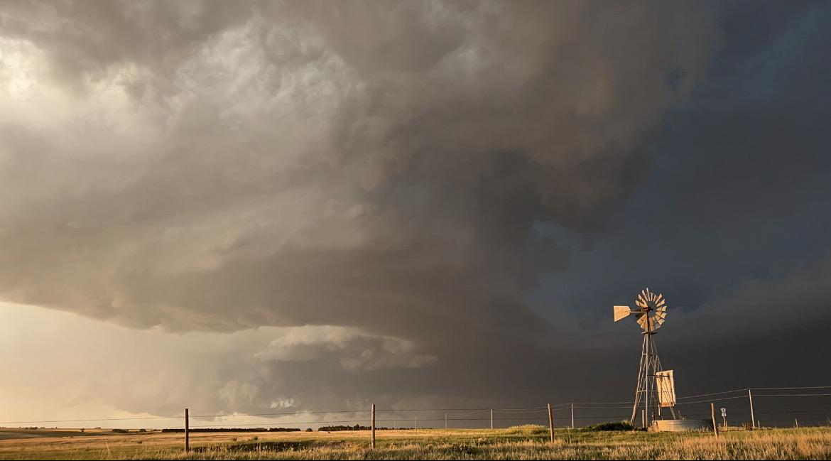
Severe weather forecasting trip
〰 Day 4 〰
By: Charles Griebell, Jeremy Lewan
& Kyle Reiman
Notes:
Jeremy

Slide 2
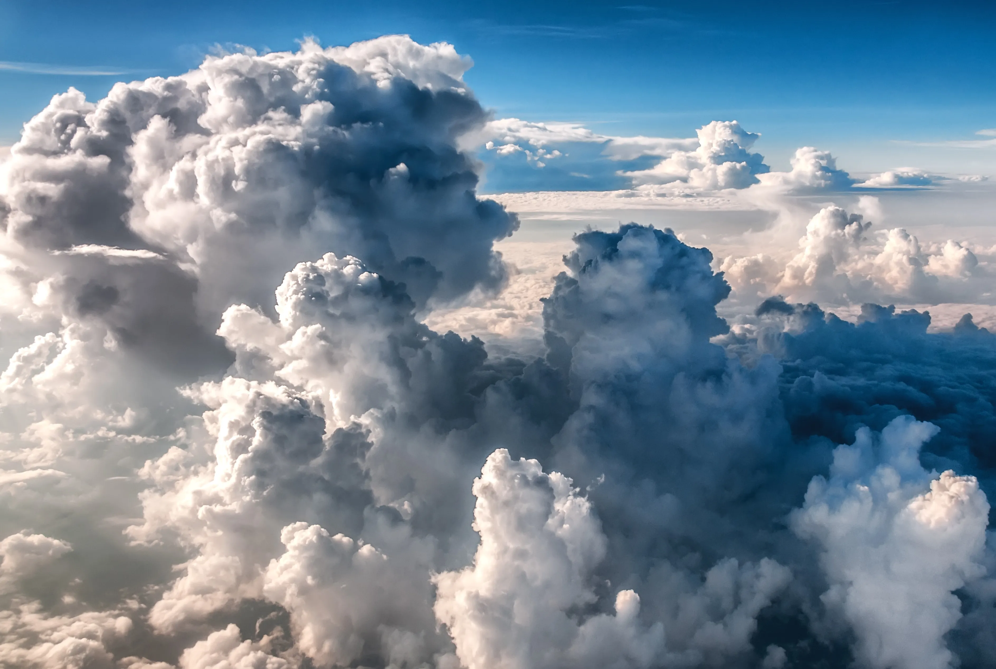

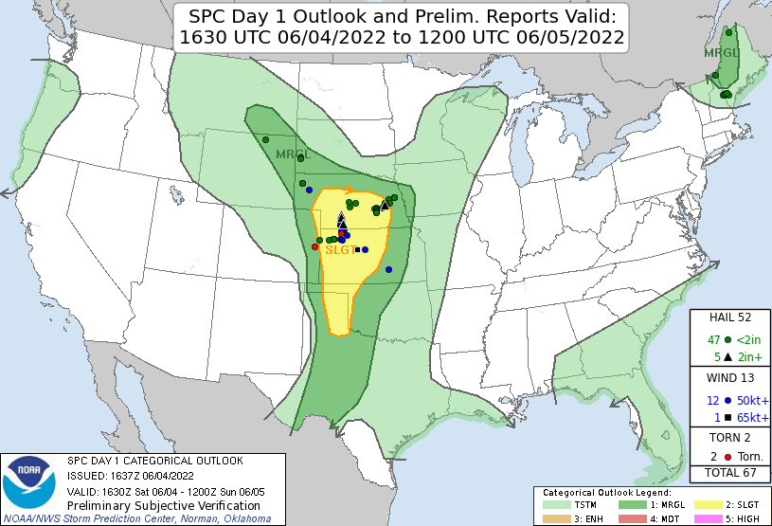
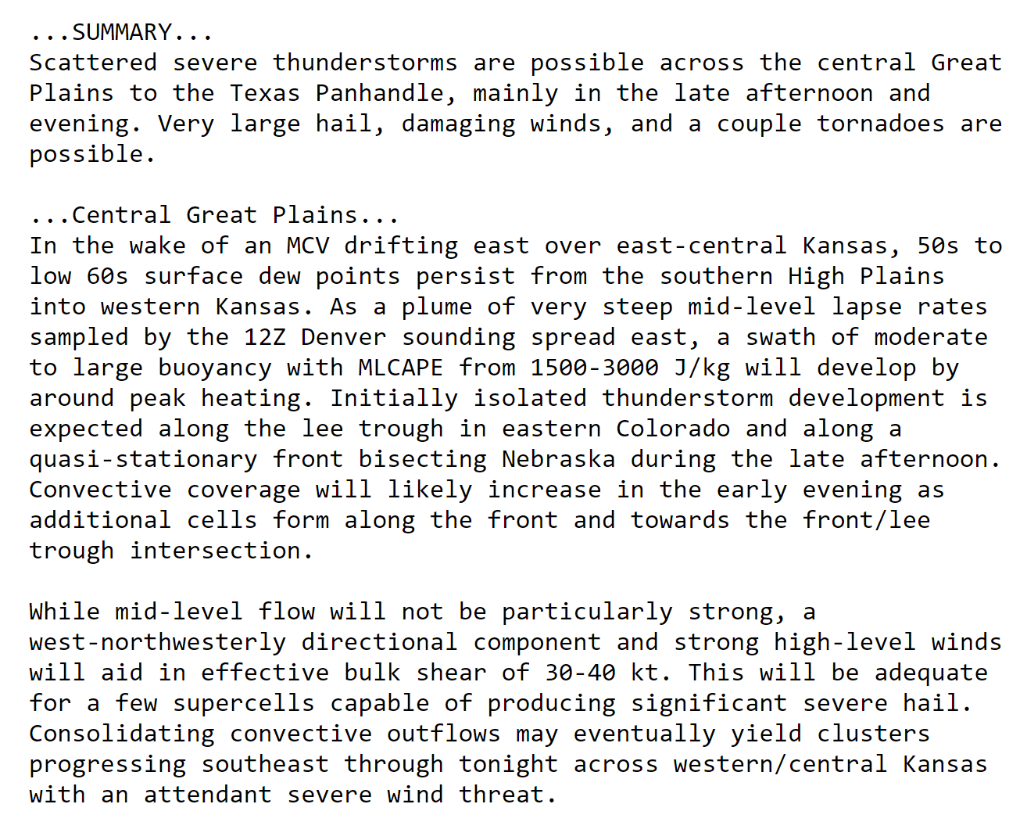

Notes:
Jeremy

Slide 3
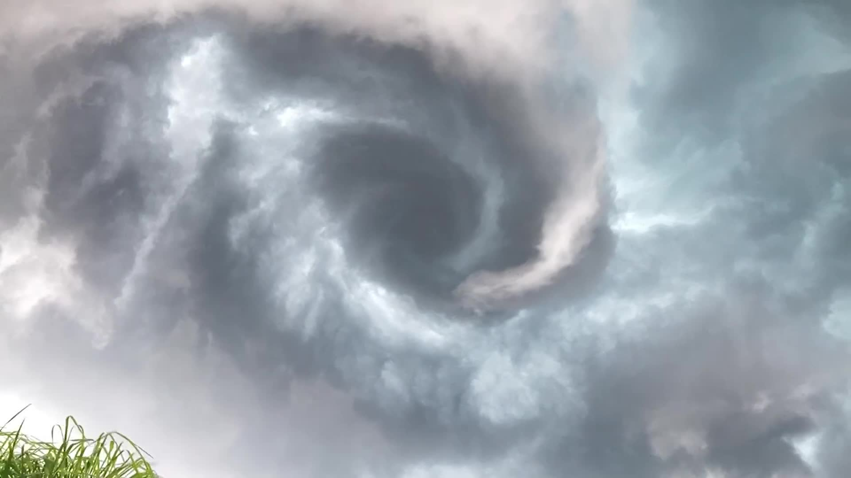
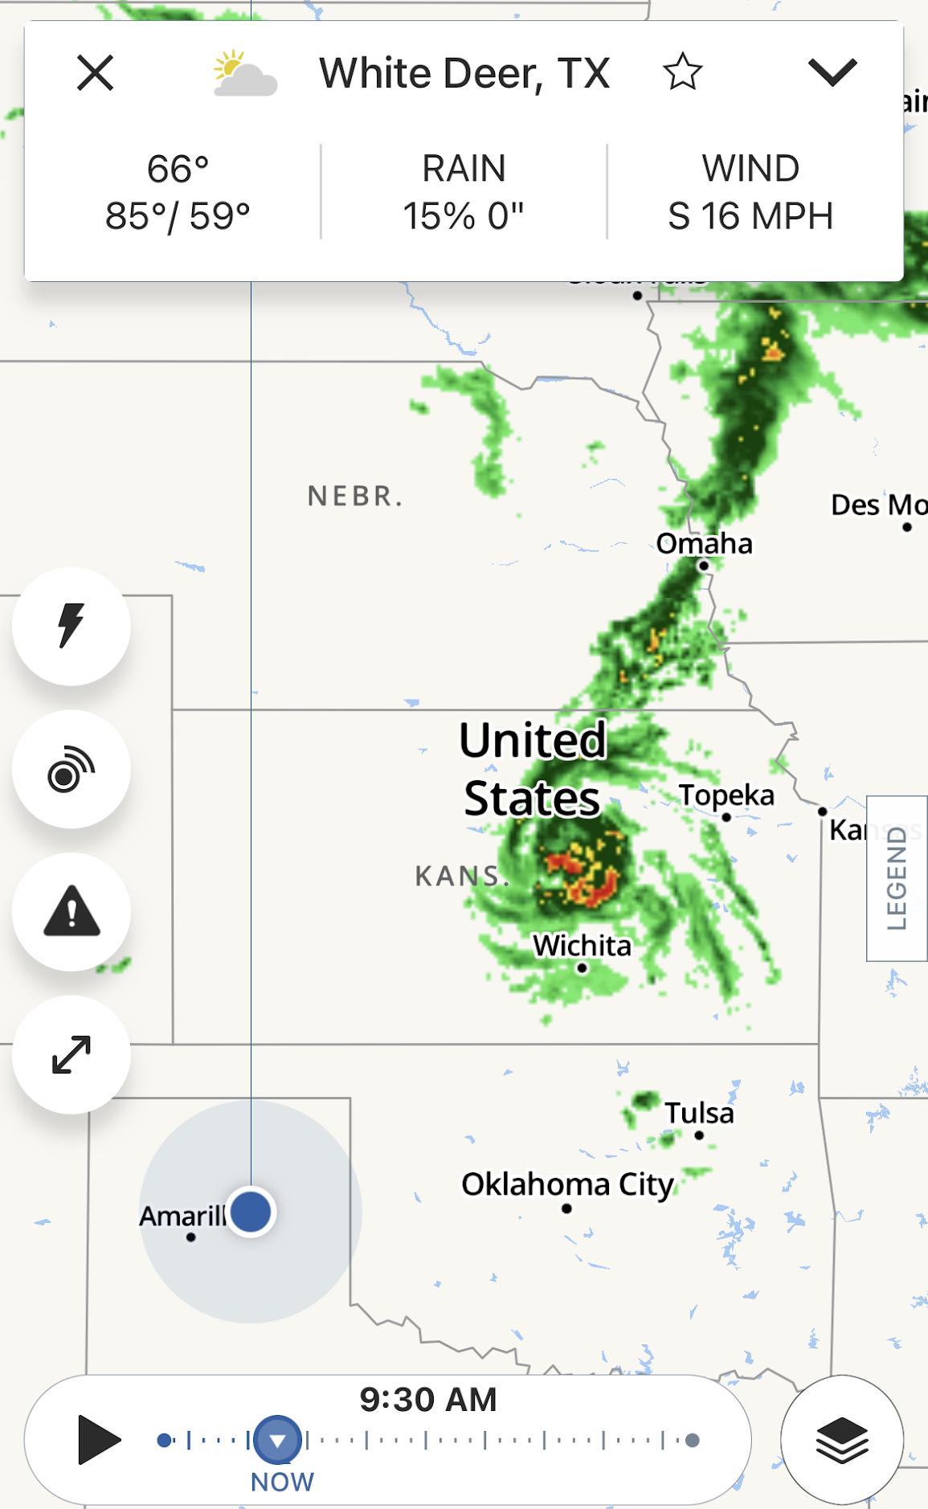
MCV
Mesoscale Convective Vortex
  aka “Mesovortex”
Forms from MCS (Mesoscale Convective System), where a low-pressure center pulls wind into a swirling pattern, resembling a mini-hurricane
Can persist for hours after the parent MCS has dissipated
Can provide outflow boundaries that serve as sources of lift and instability for future storms
(CDT)
Notes:
Jeremy

Slide 4
Notes:
Jeremy

Slide 5
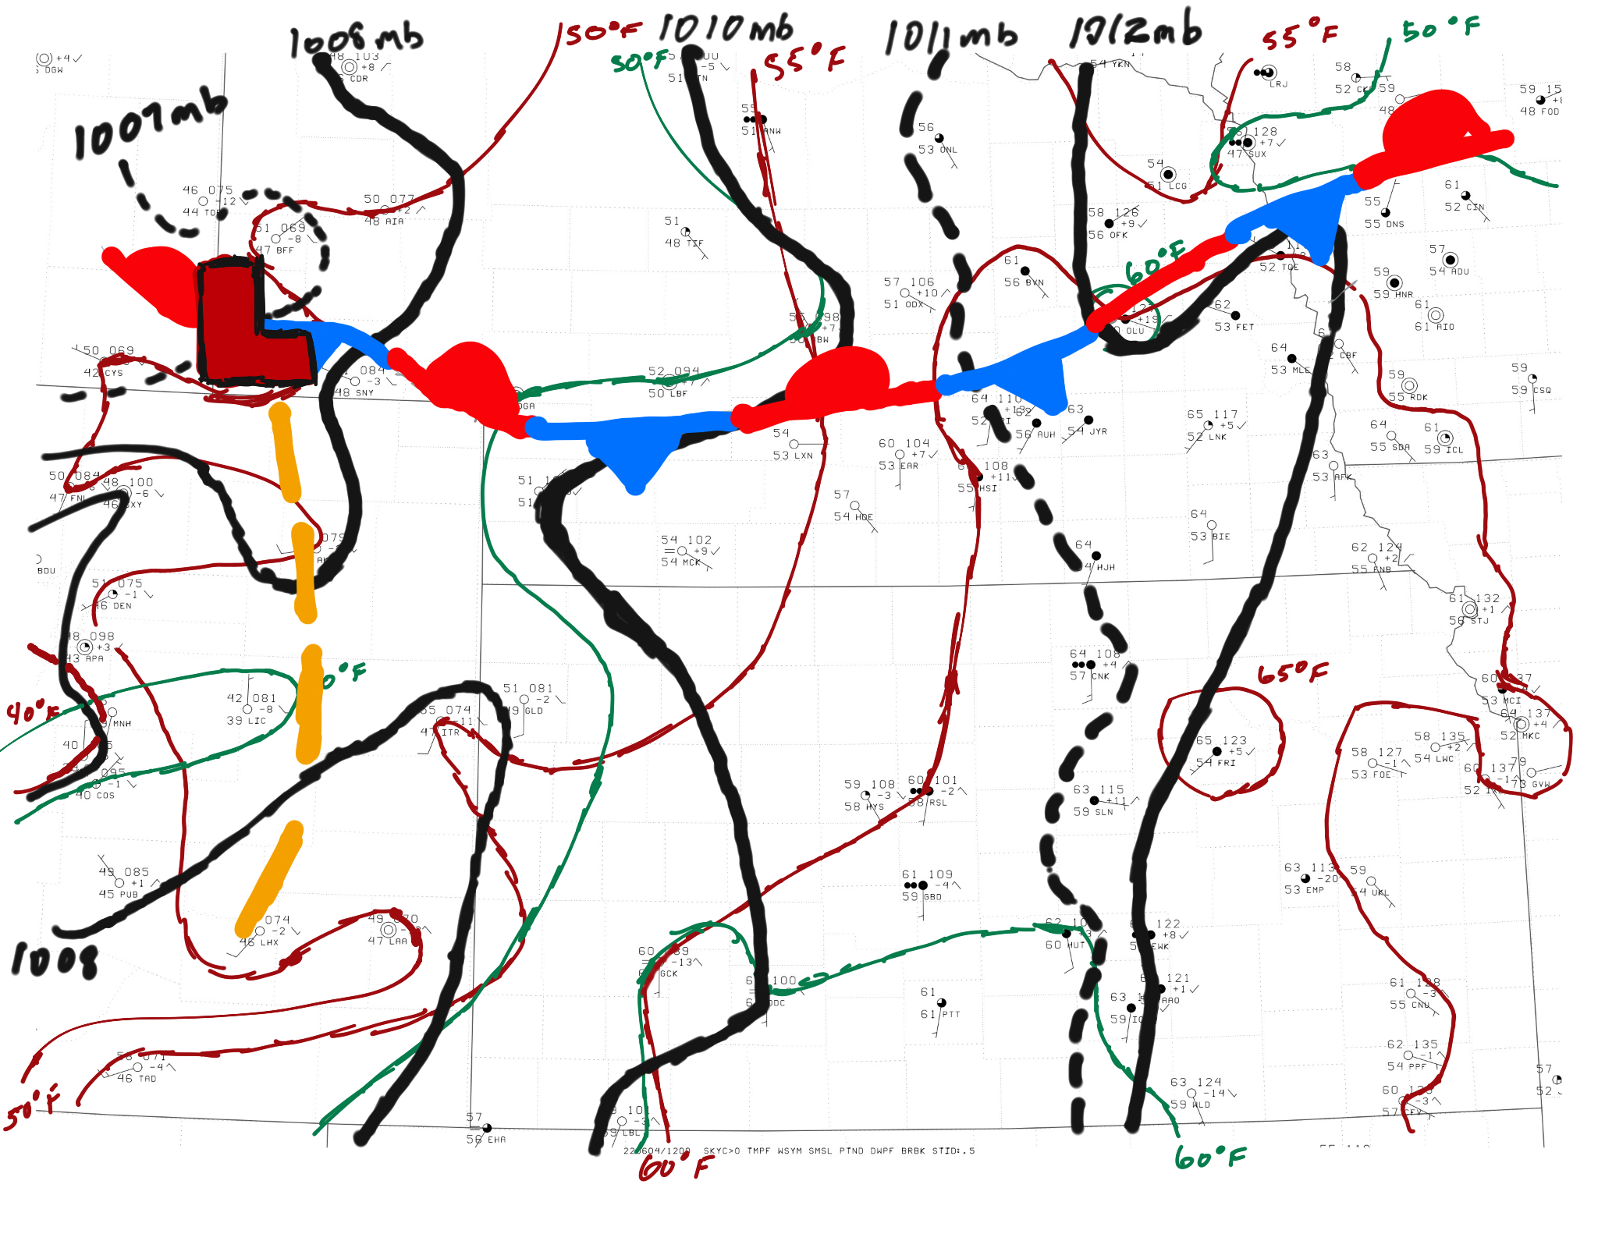
12Z Surface Analysis
Moisture Advection
Higher the dewpoint, the easier it is to get a cloud!
Notes:
Kyle

Slide 6
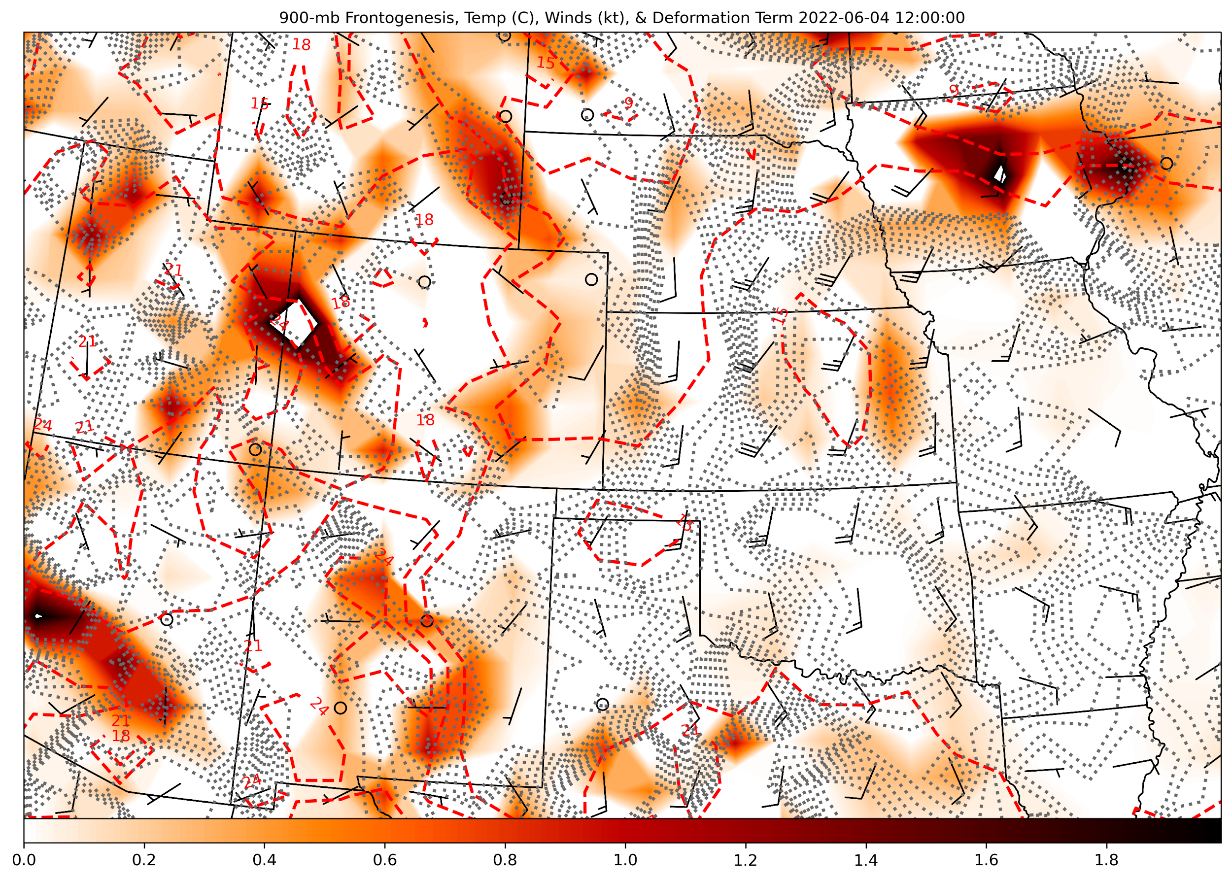
Frontogenesis
& Deformation
Highlighted areas of frontogenesis and deformation are associated with frontal boundaries seen on the surface analysis
Notes:
Kyle

Slide 7
Notes:
Jeremy

Slide 8

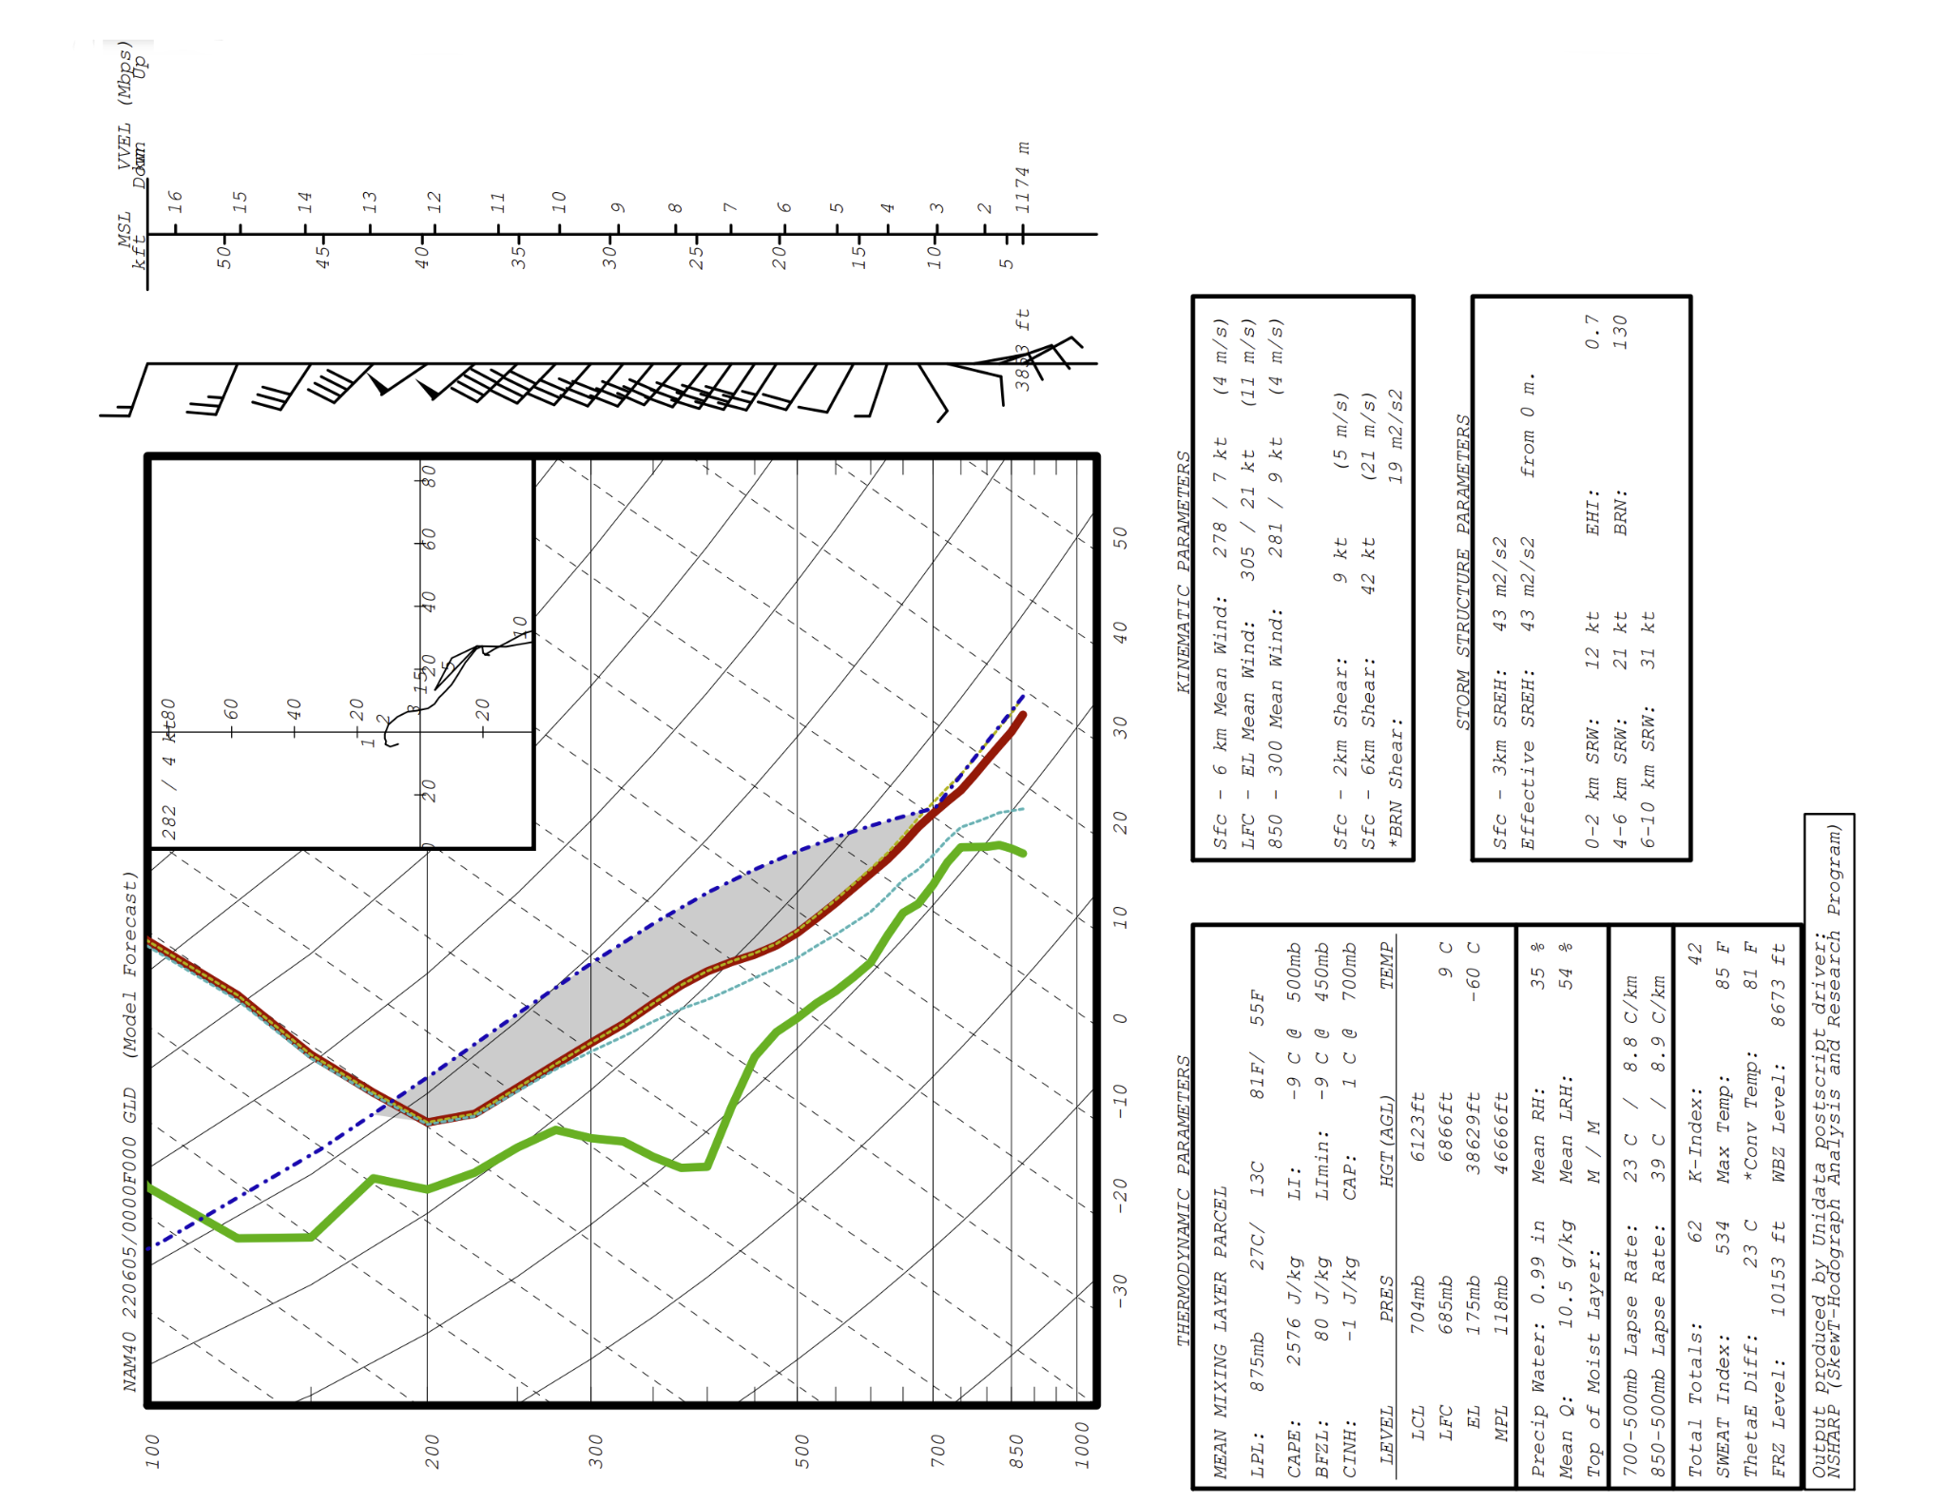
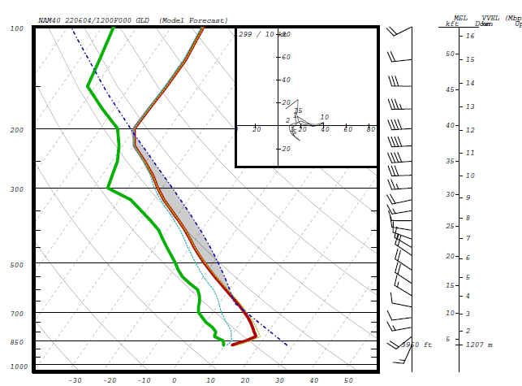
Soundings from Goodland (KGLD)
12Z (6 AM MDT)
0Z (6 PM MDT)
Notes:
Jeremy

Slide 9
Sounding from Goodland (KGLD) + Important Parameters
2576 J/kg of CAPE
> 1500 J/kg ✅
Total Shear: 42 kt
> 40 kt ✅
Low Level Veering
Good for Tornadoes ✅
Total Totals: 62
>60 = High Prob of Svr Wx ✅
Notes:
Jeremy

Slide 10
Sounding from Goodland (KGLD) + Important Parameters
Lifted Index: -9
Potential for Outbreak ✅
SWEAT Index: 534 > 400 = High Prob of Torns. ✅
Effective Storm Relative Helicity: 43 m²s²
<125 m²s² ❌
Bulk Richardson Number: 19 m²s²
Between 10-40 = Supercells ✅
Wet Bulb Zero: 2.64 km
Between 2.1 - 2.7 km ✅
Notes:
Jeremy

Slide 11
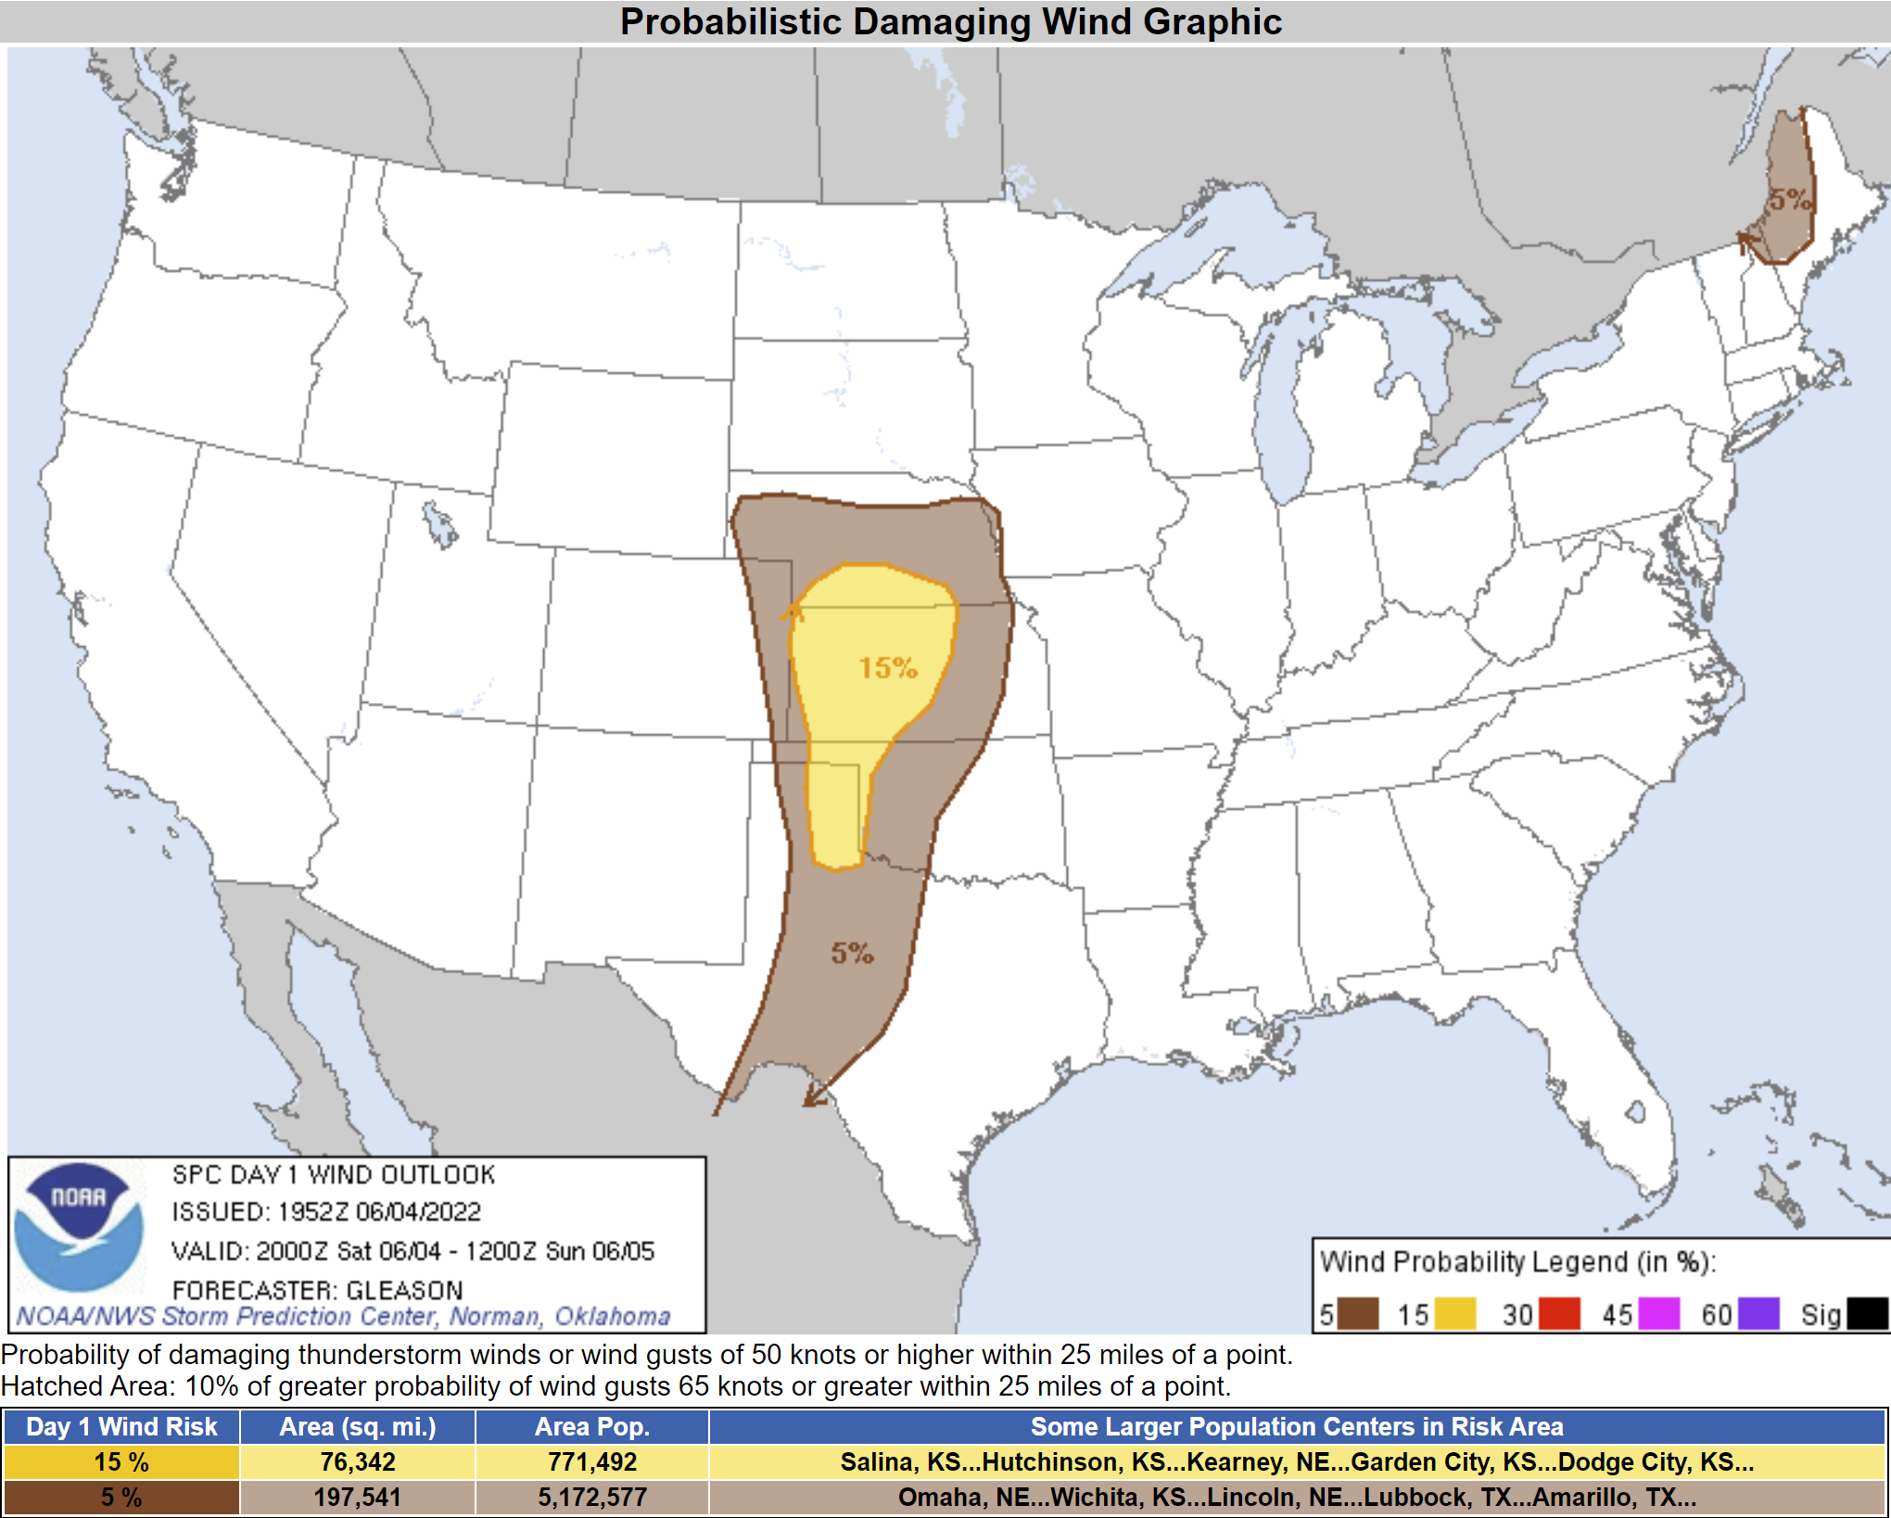
Notes:
Jeremy

Slide 12
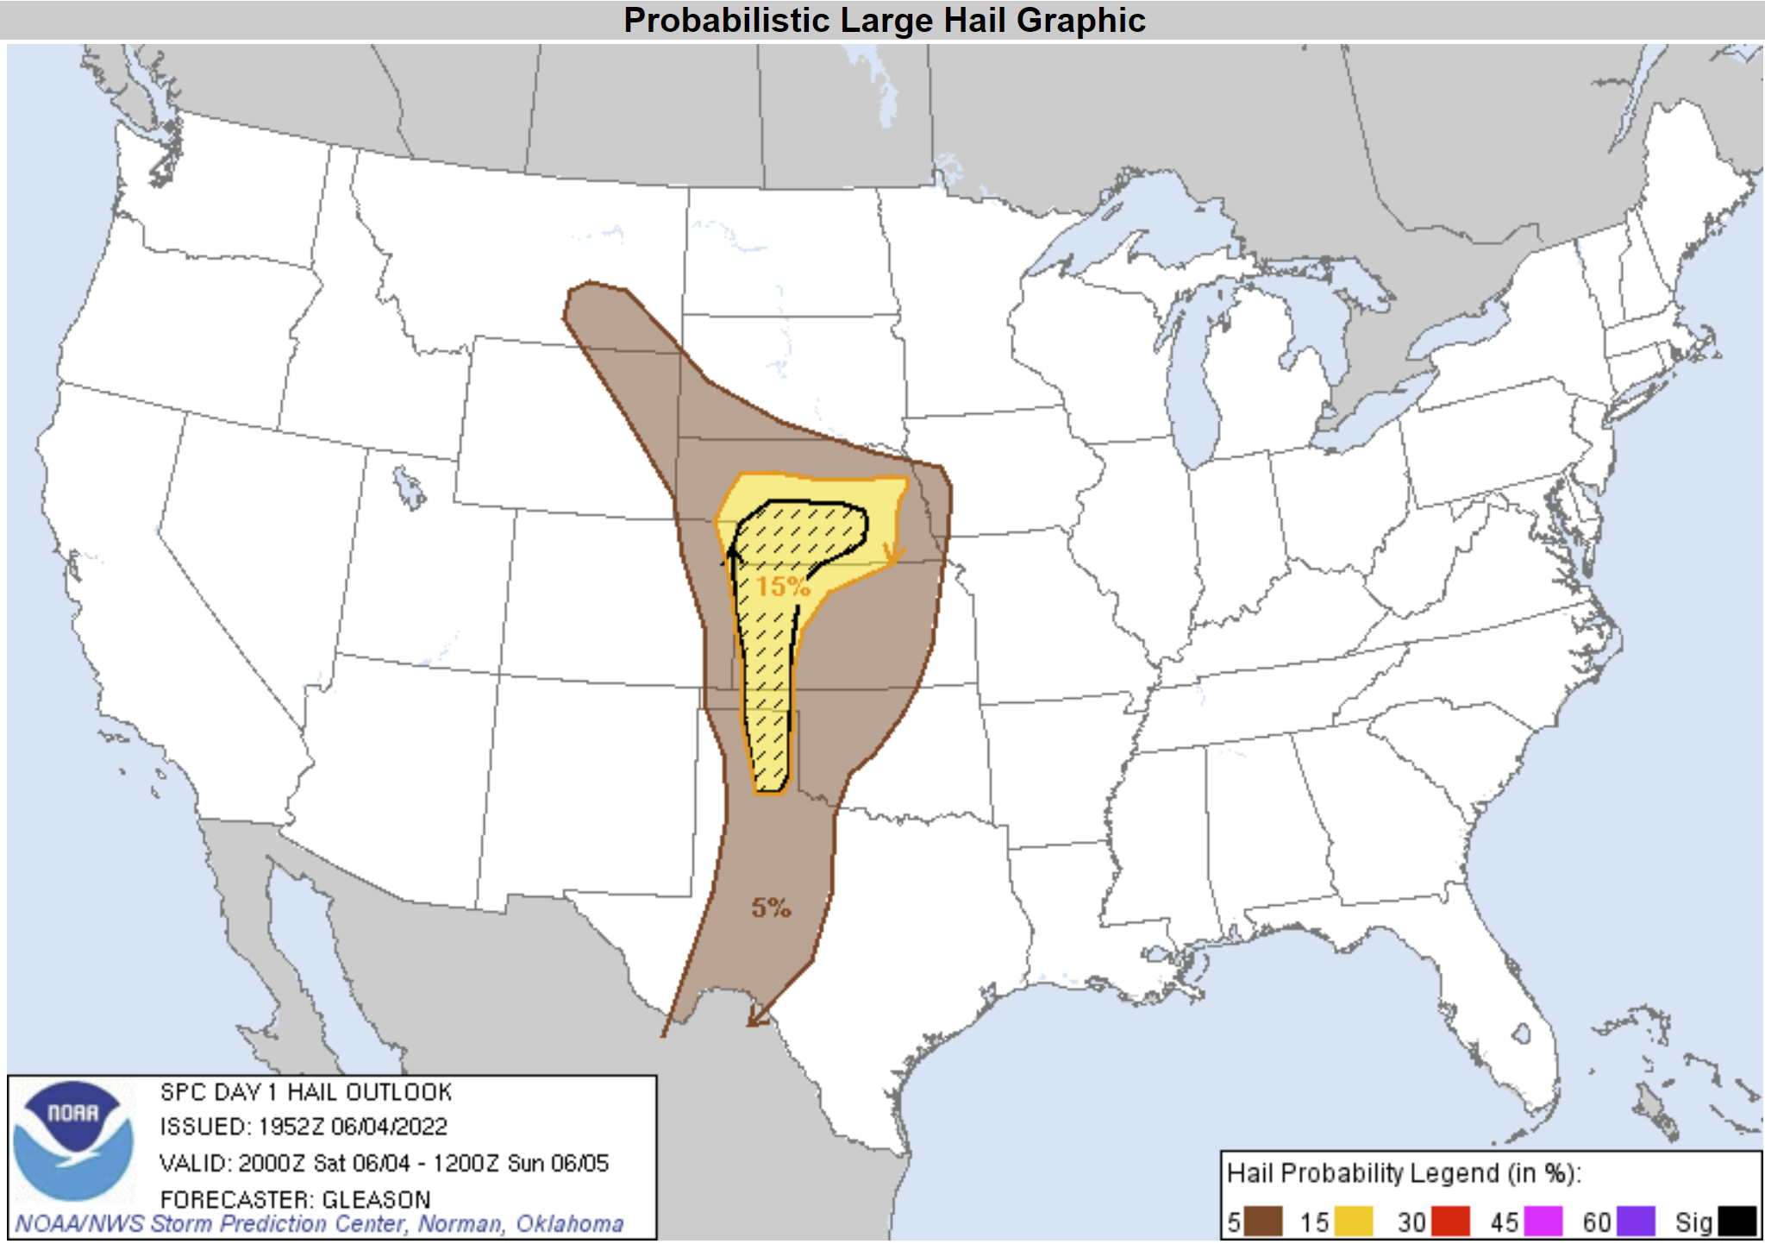
Notes:
Jeremy

Slide 13
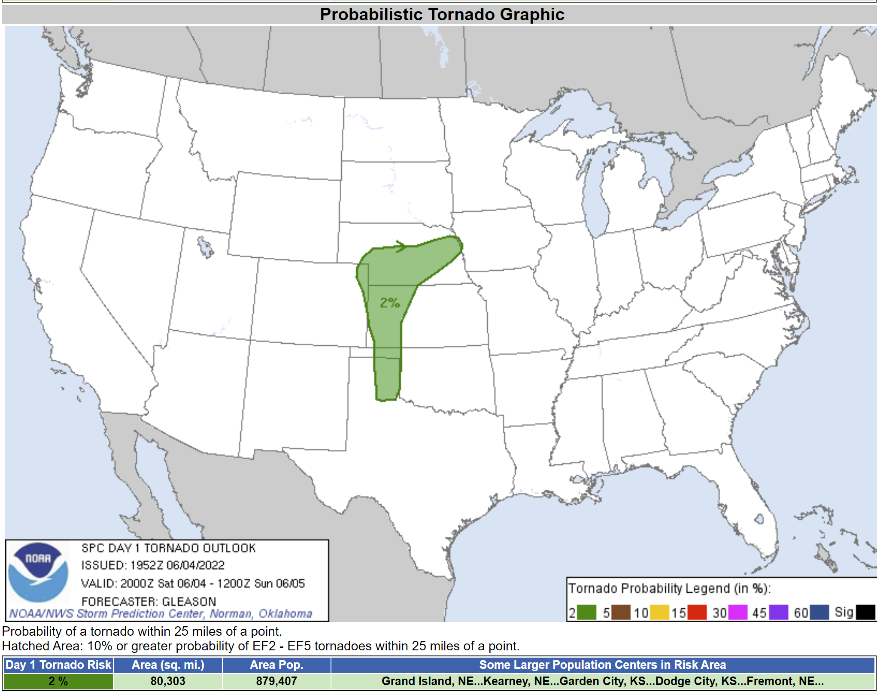
Notes:
Jeremy

Slide 14
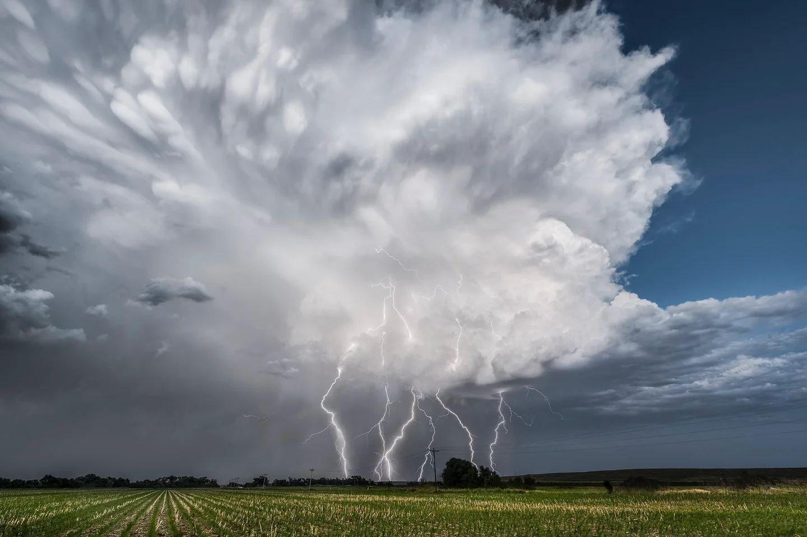
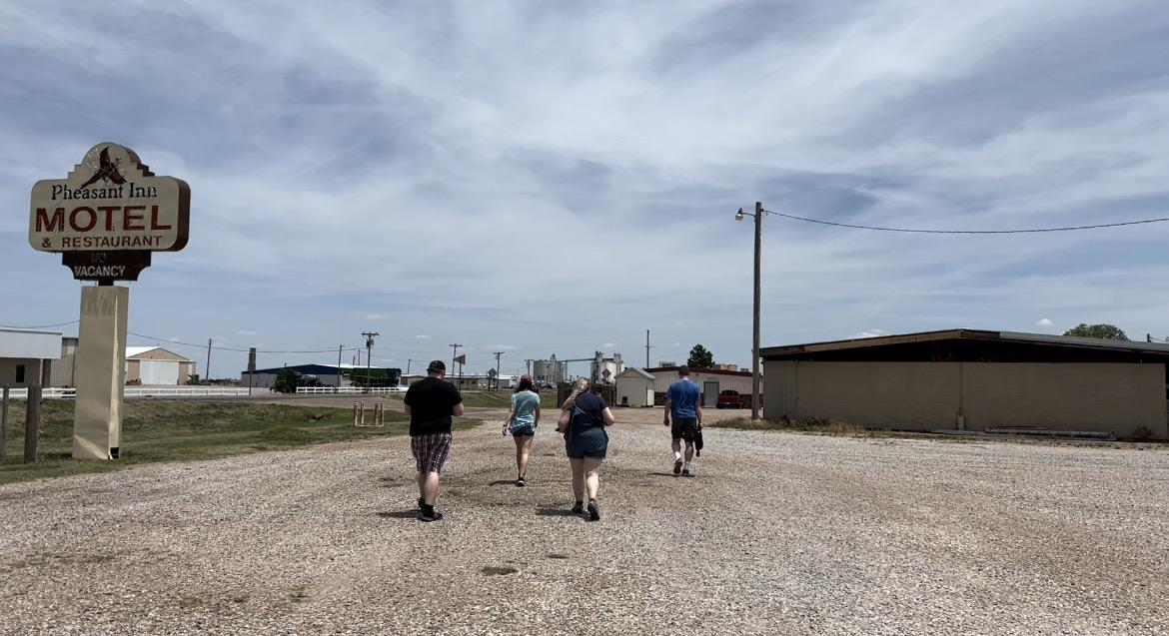
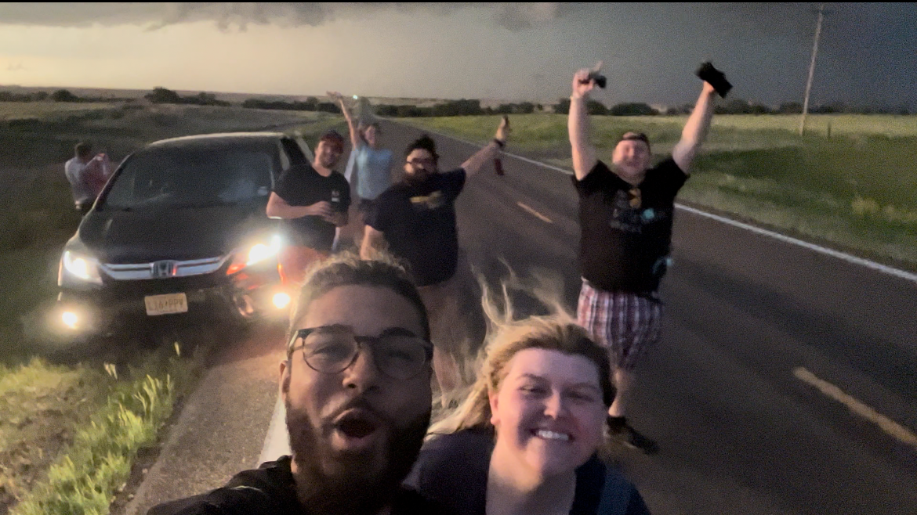
So, how did our day go from this?
To this?
Notes:
Jeremy

Slide 15
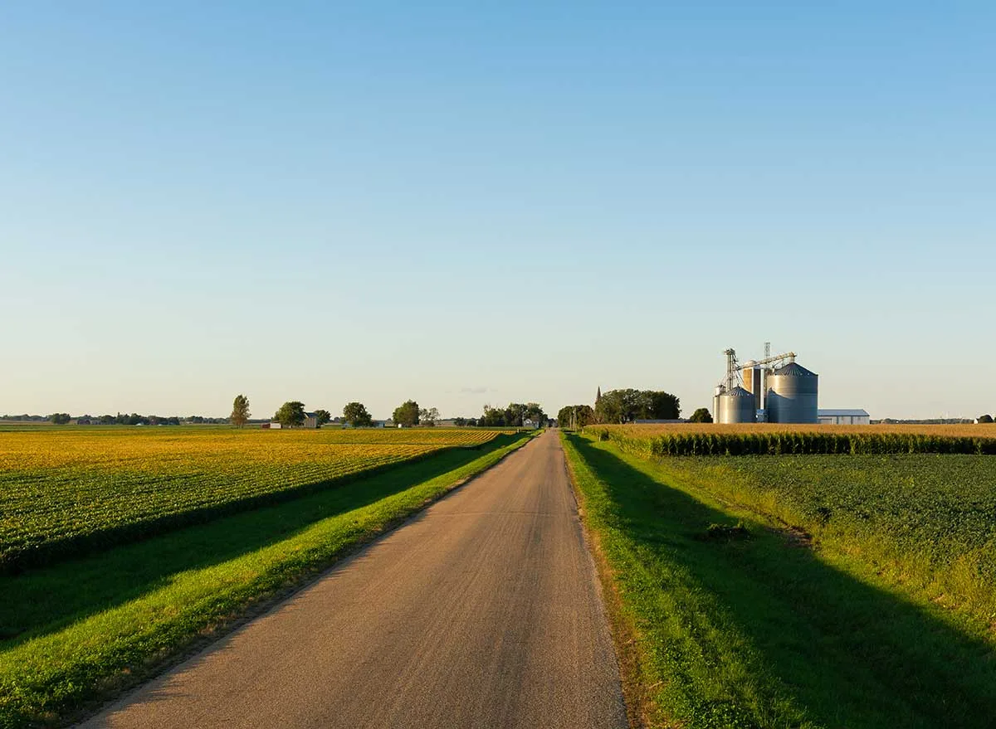
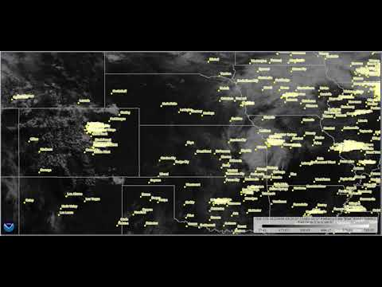
Heading Northward from Amarillo!
Relatively clear skies can be seen over Western Kansas.
This allowed for significant heating
= Instability
Early on in the day, there was a thin layer of stratus clouds Draped across the Midwest.
Notes:
Charles

Slide 16
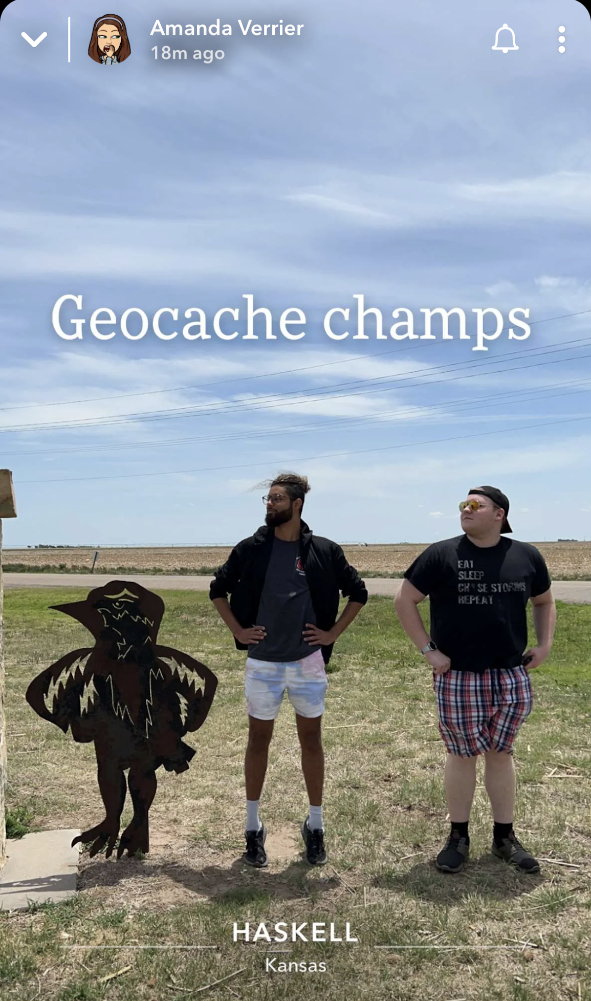
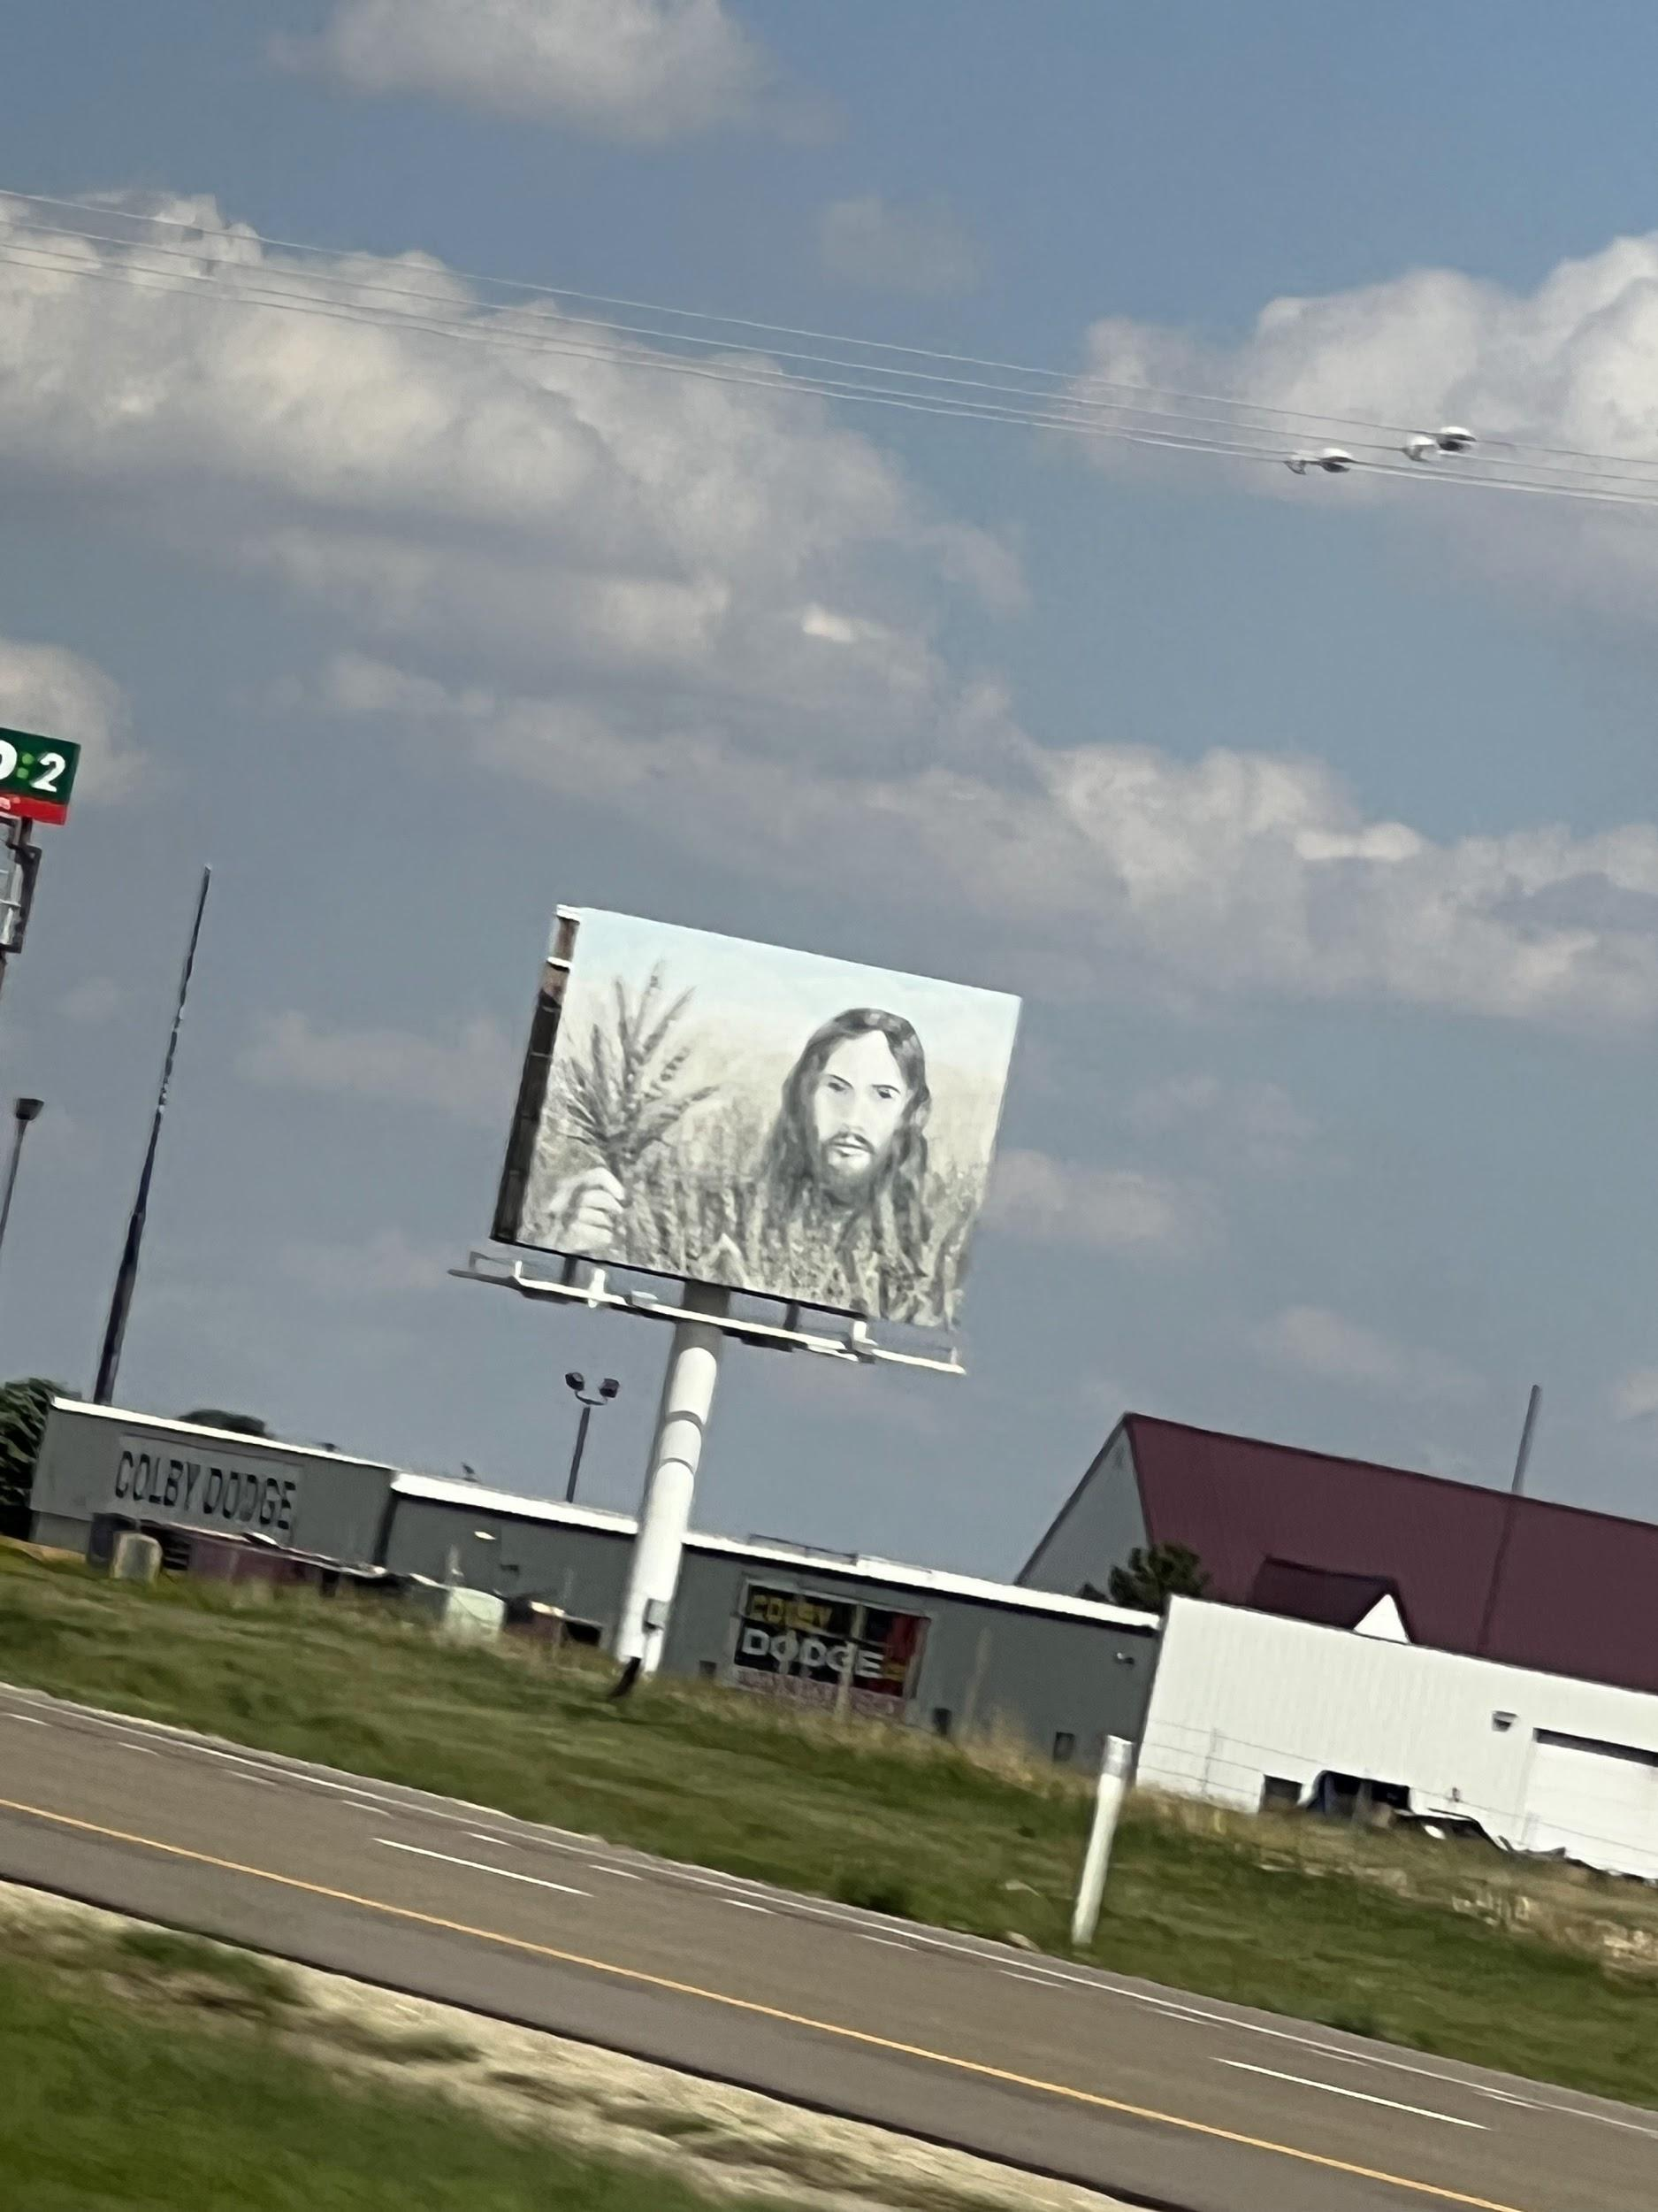
Heading Northward from Amarillo!
Geocaching after lunch at Macias Restaurant! (Best Lemonade Ever!)
Wheat JesuS
Haunting us all over kAnsas
Notes:
Jeremy

Slide 17
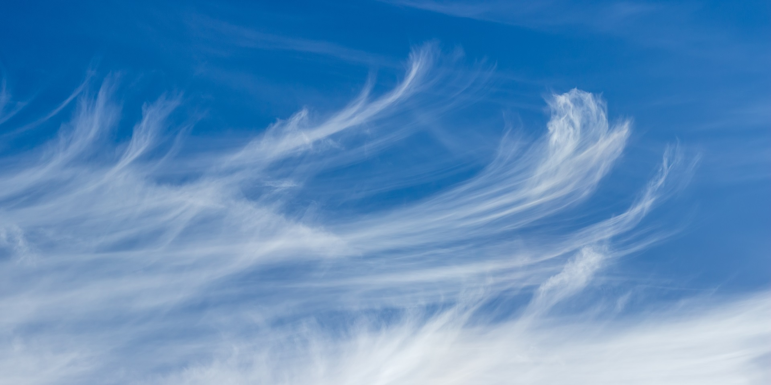

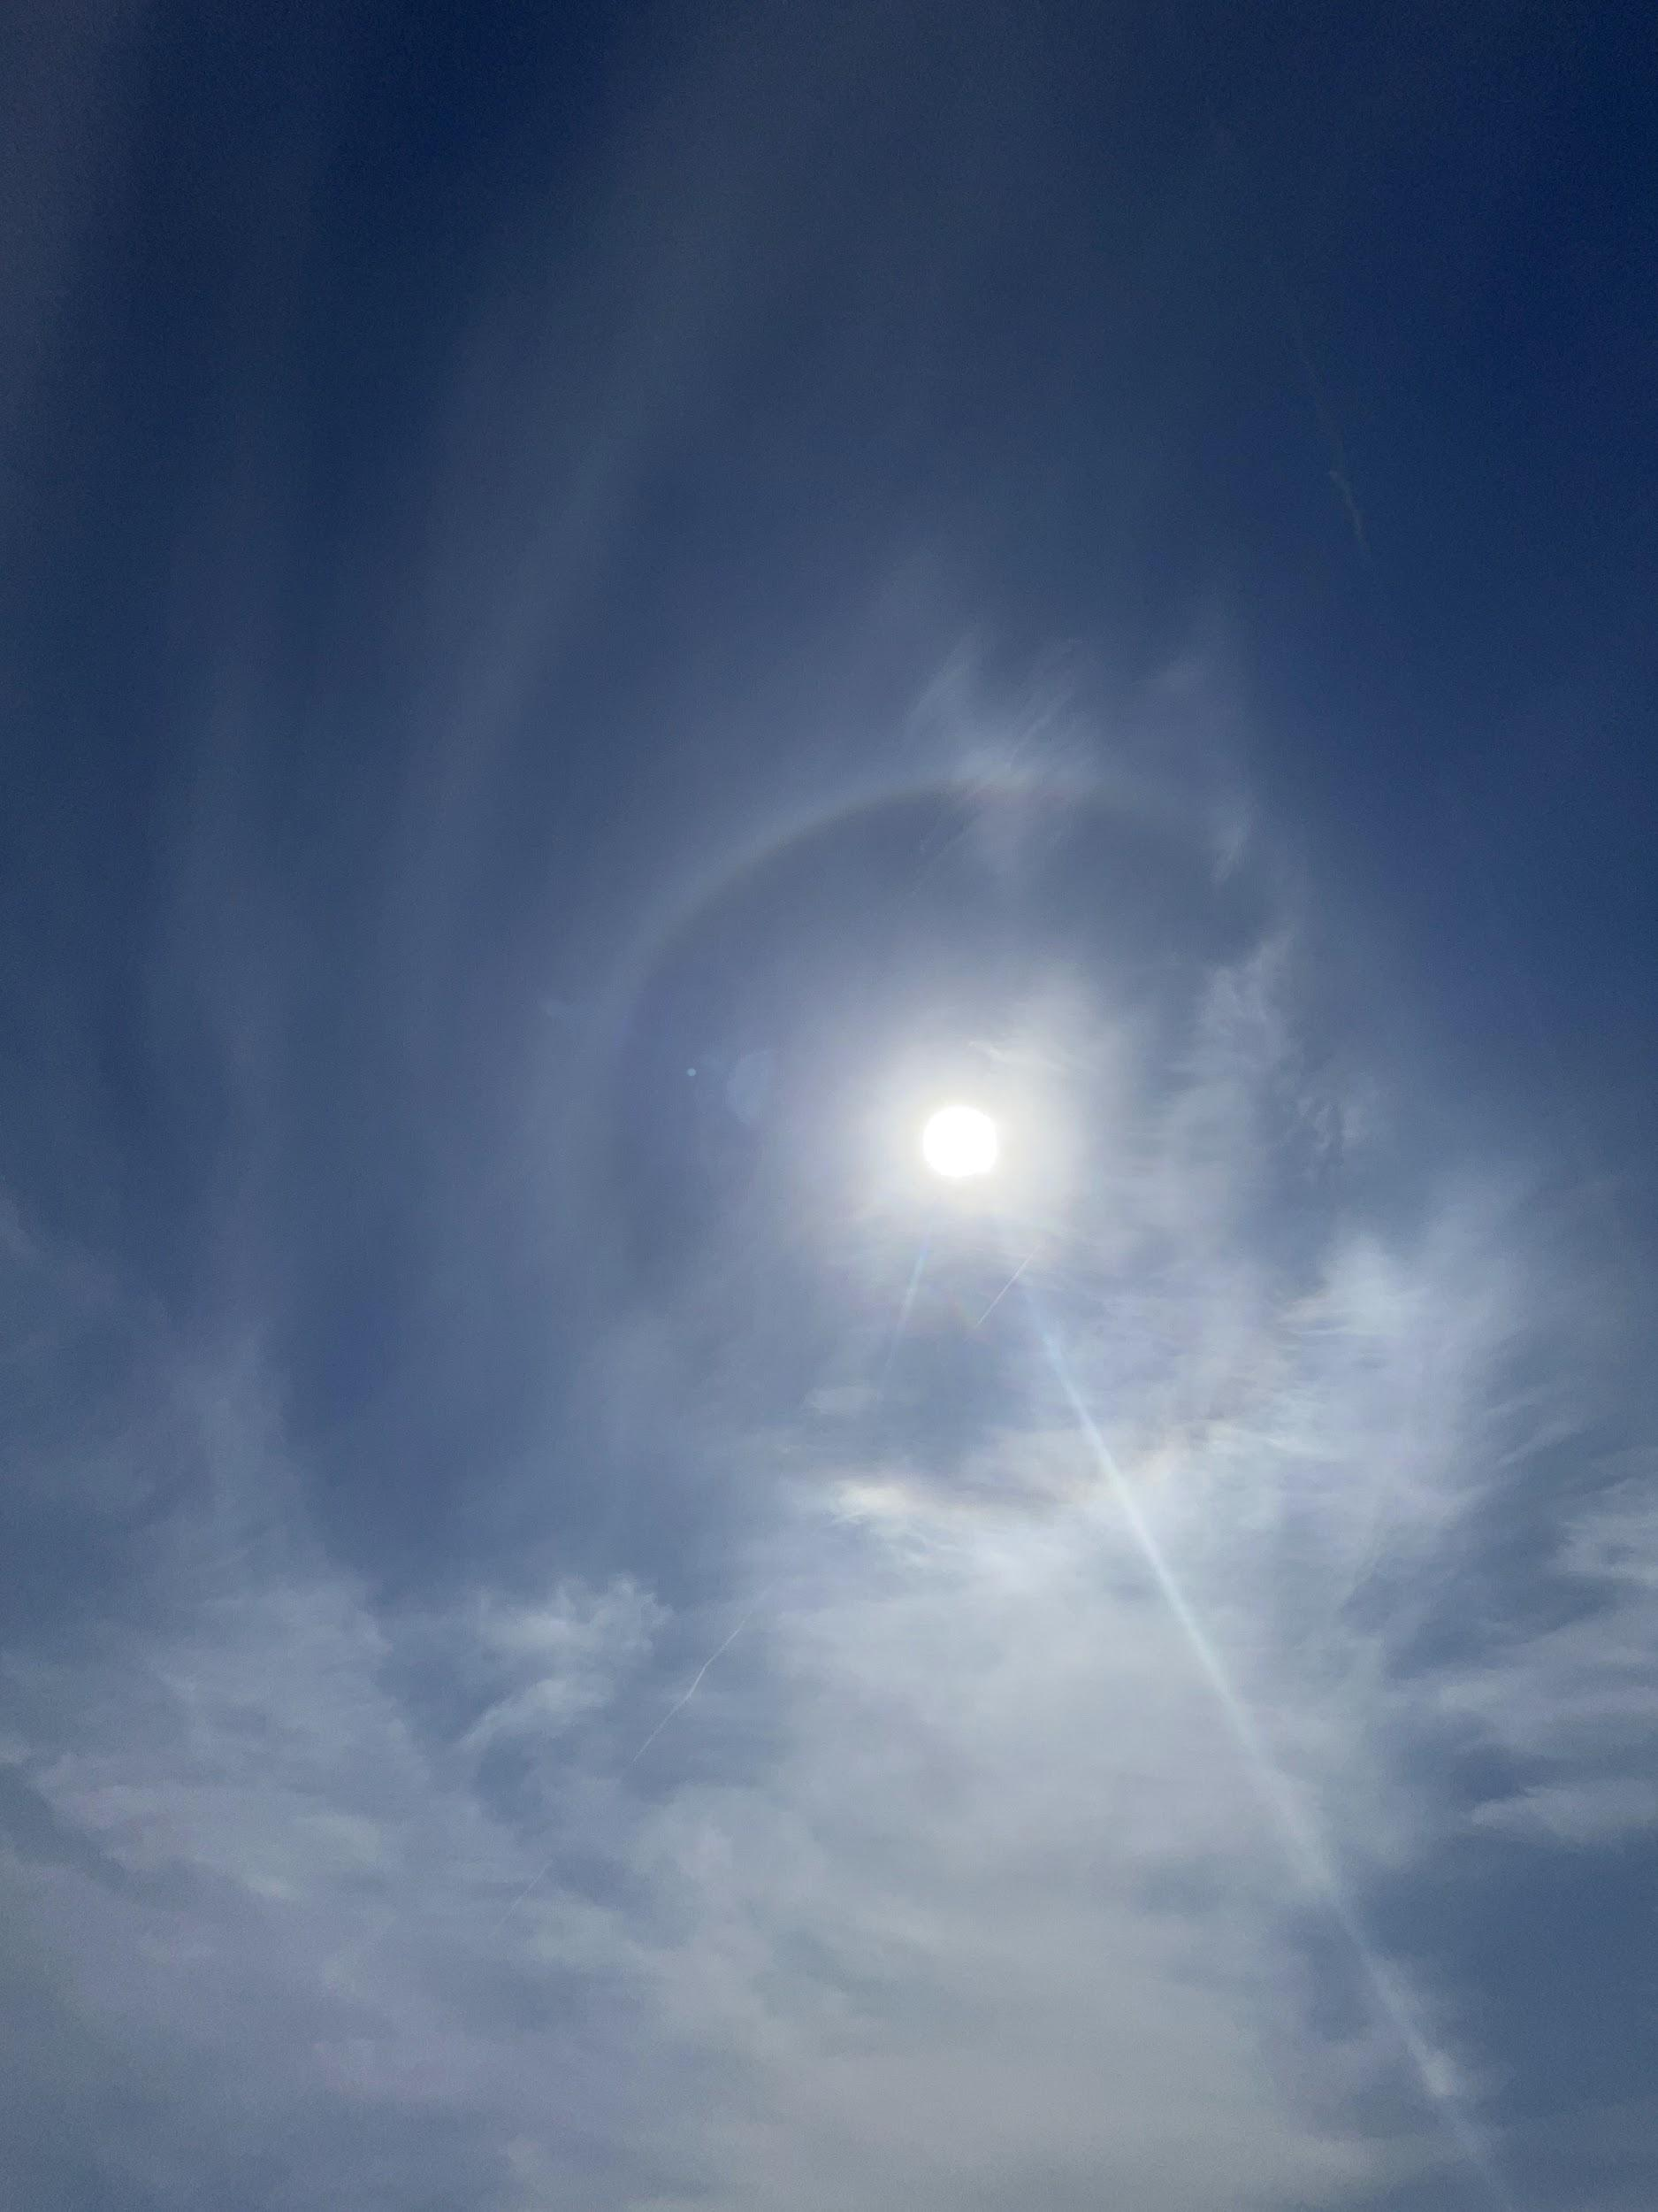
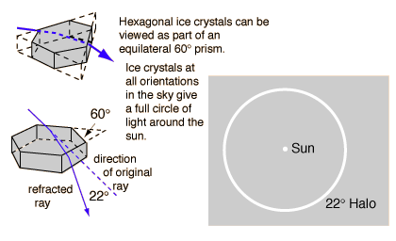
22° Halo
We also witnessed a beautiful full 22° Halo along the way!
**Everyone sees their own unique halo because they see different ice crystals!**
Notes:
Kyle

Slide 18
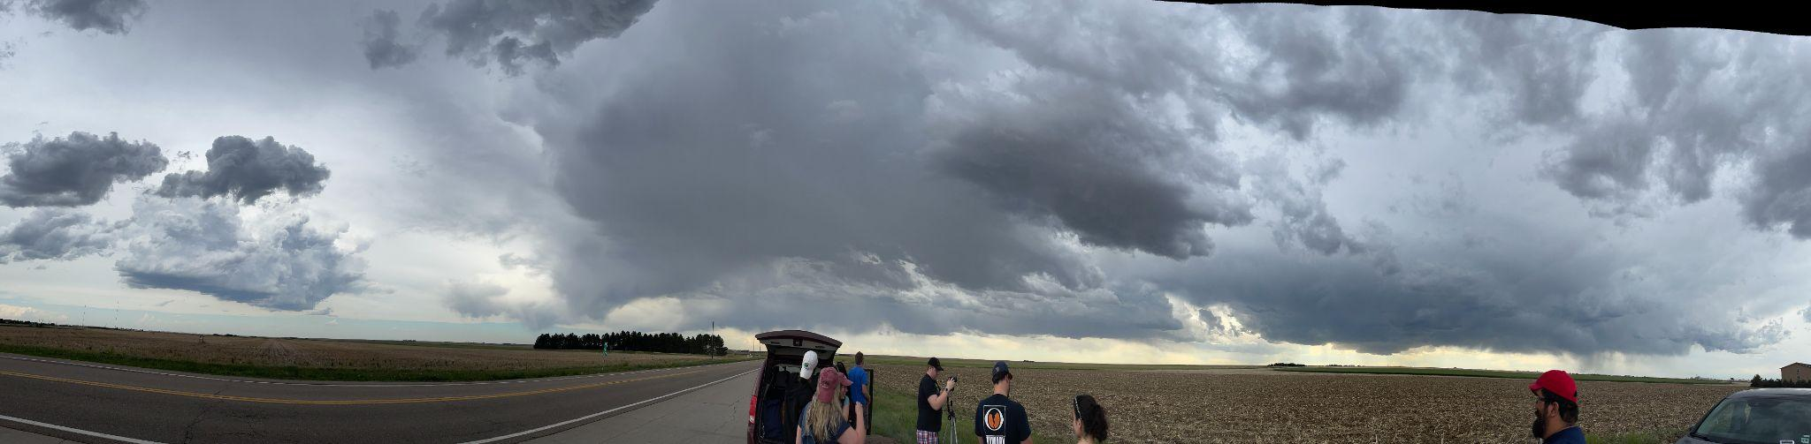
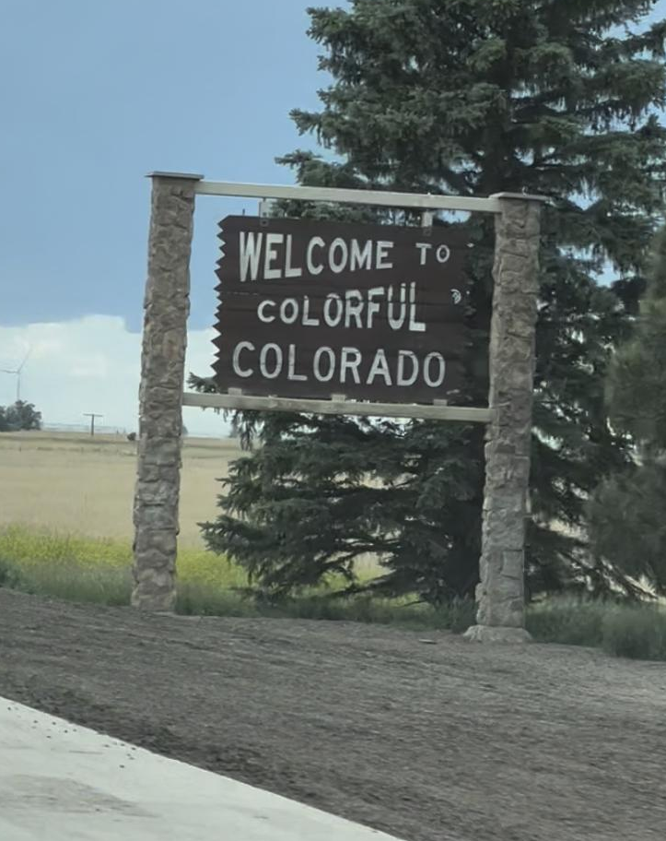
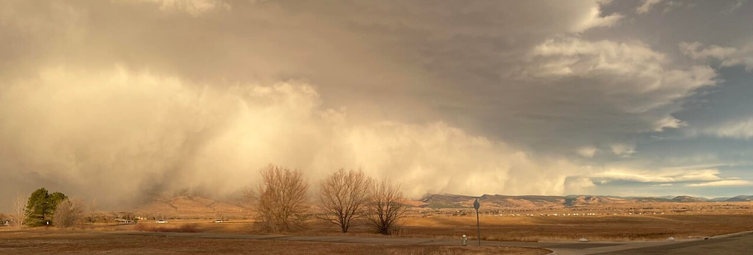
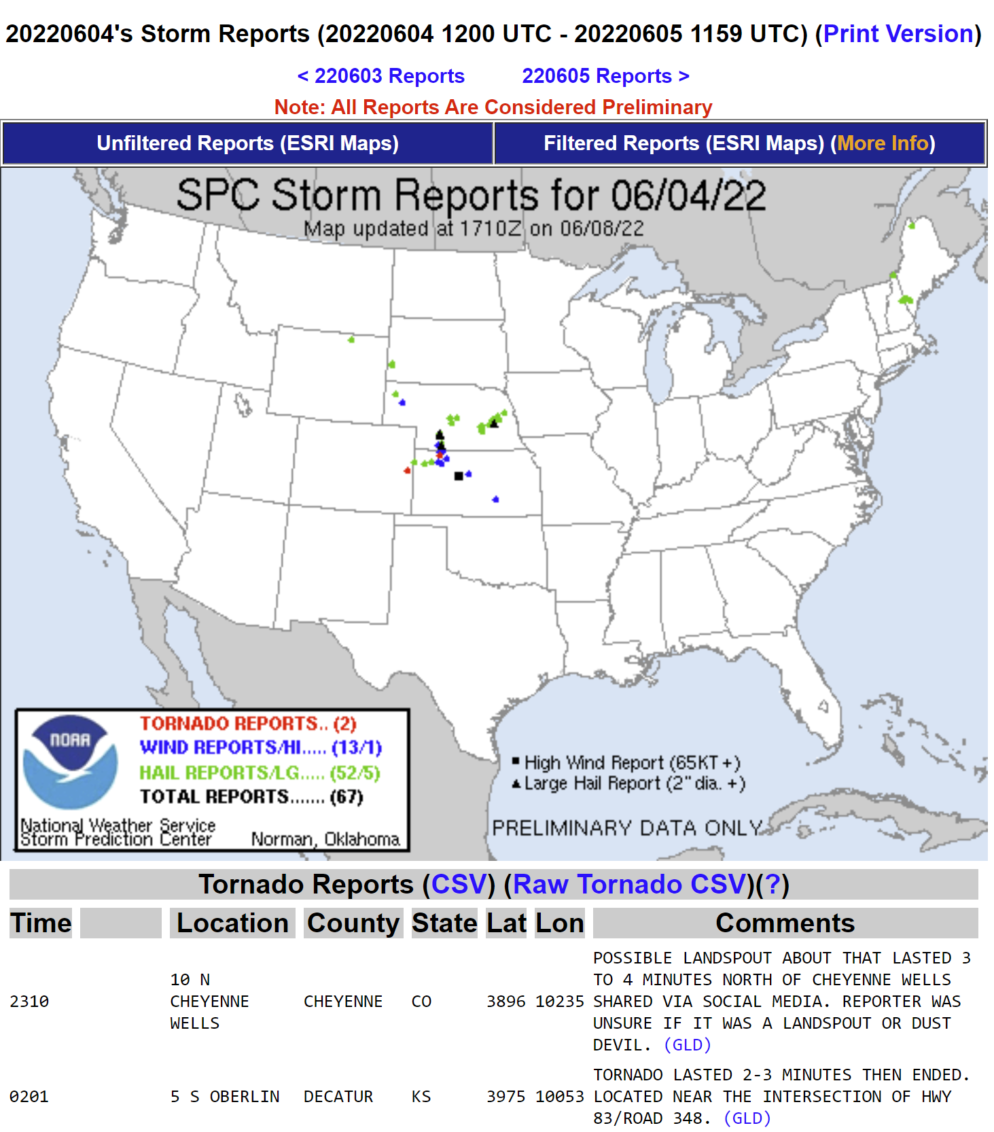
Entering Colorado
We had an awesome view because the storm was an LPSC (low precipitation supercell)
Luanne and Jeremy spotted a gustnado to the south of I-70 before entering Burlington, CO
Notes:
Charles

Slide 19
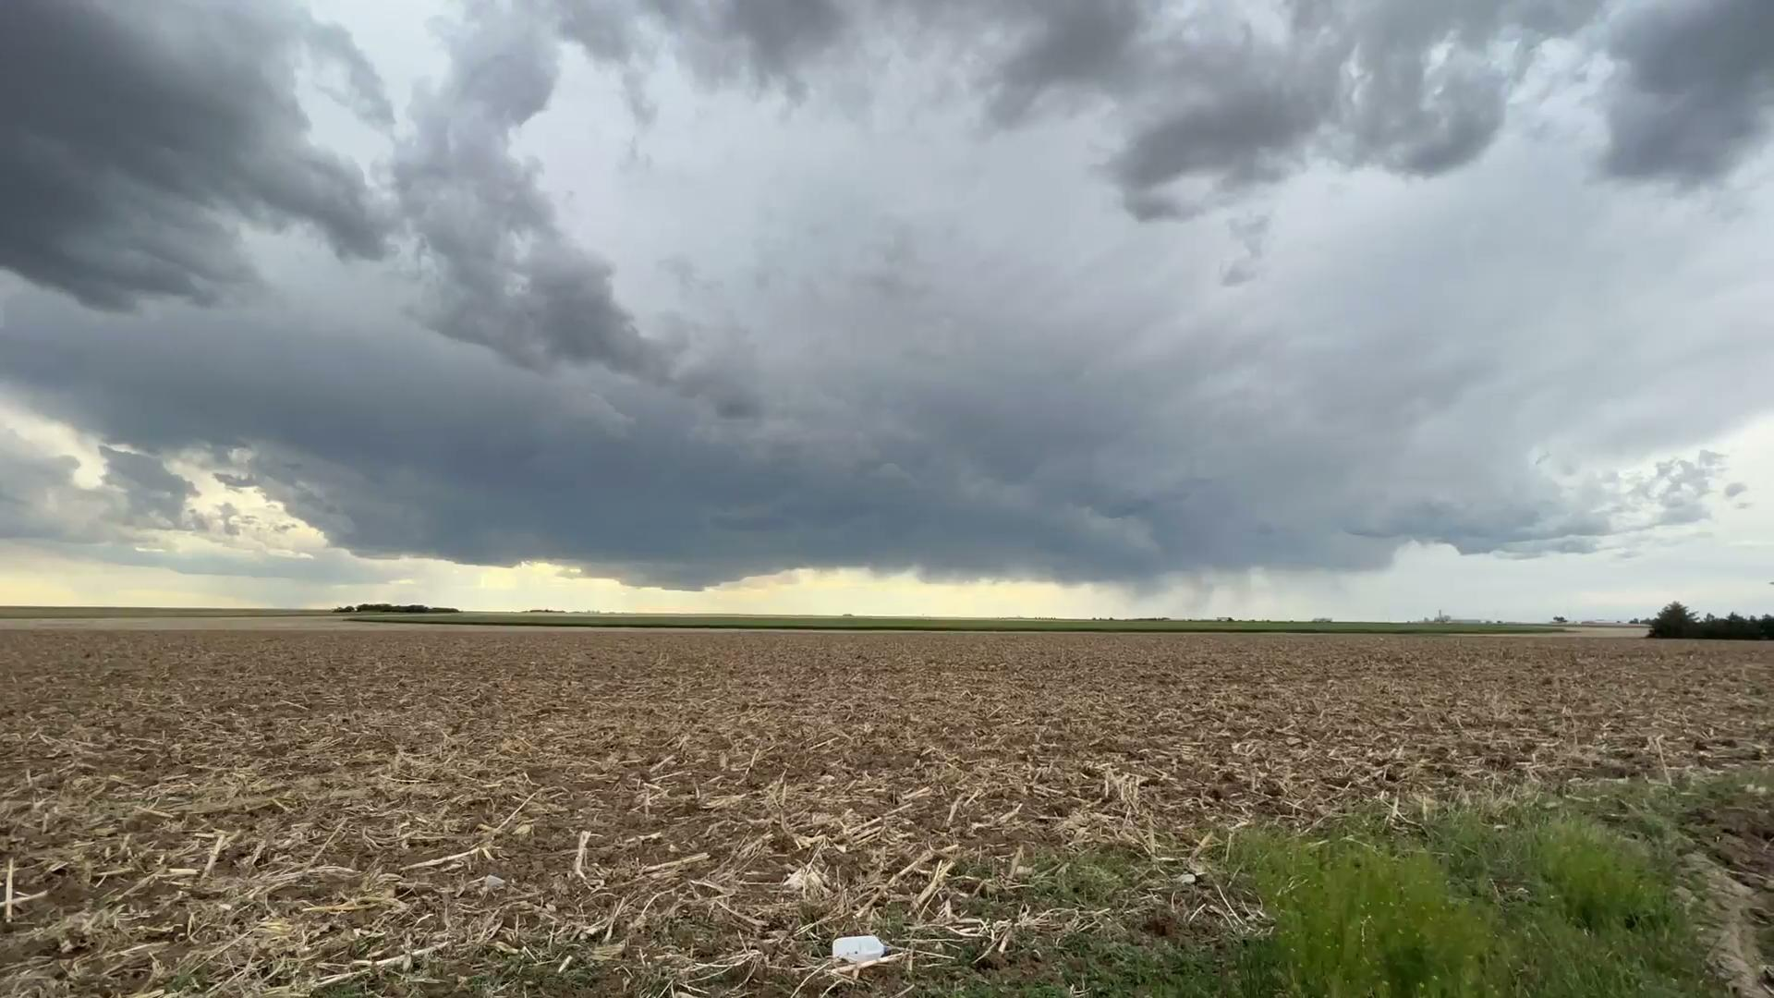
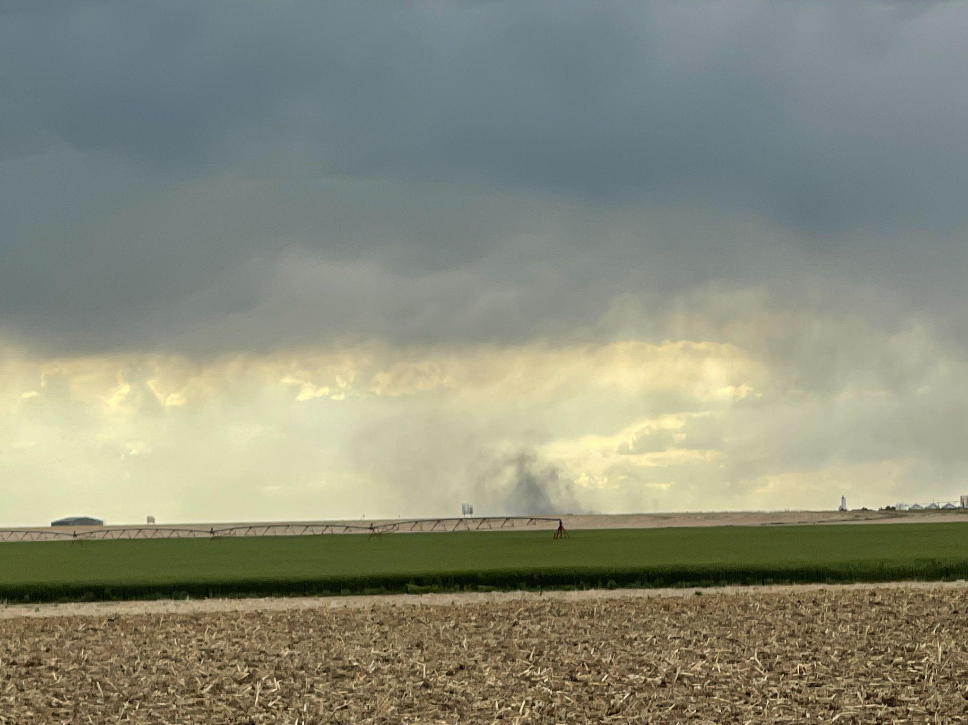
Entering Colorado
We witnessed a microburst!
Notes:
Charles

Slide 20
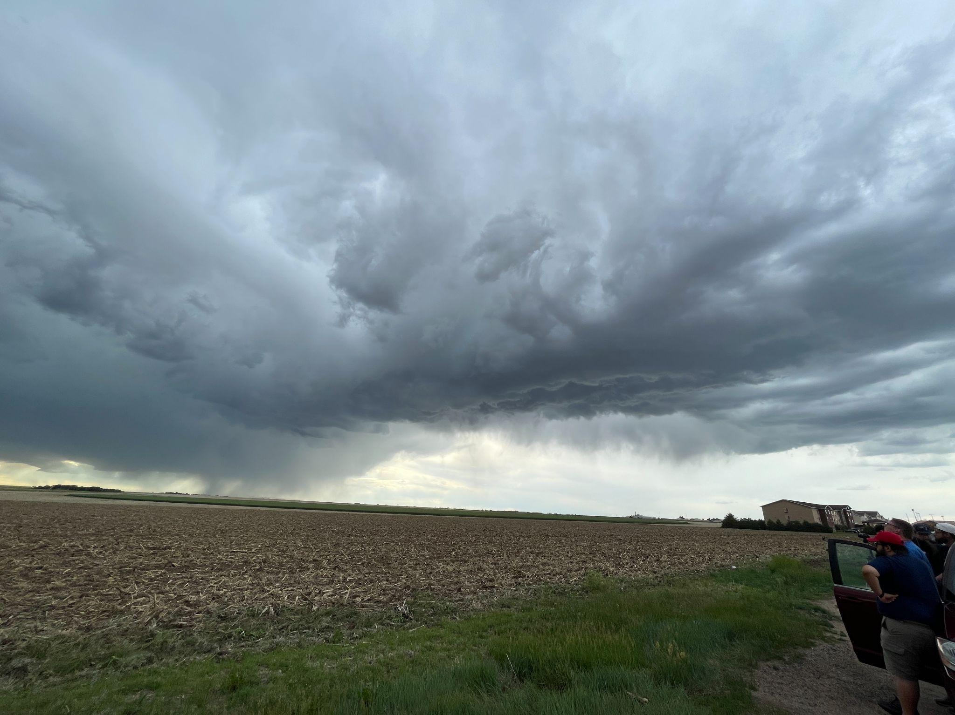
We saw multiple updrafts bases because it was so clear!
The left part of the cloud had well-defined lowering!
Notes:
Charles

Slide 21

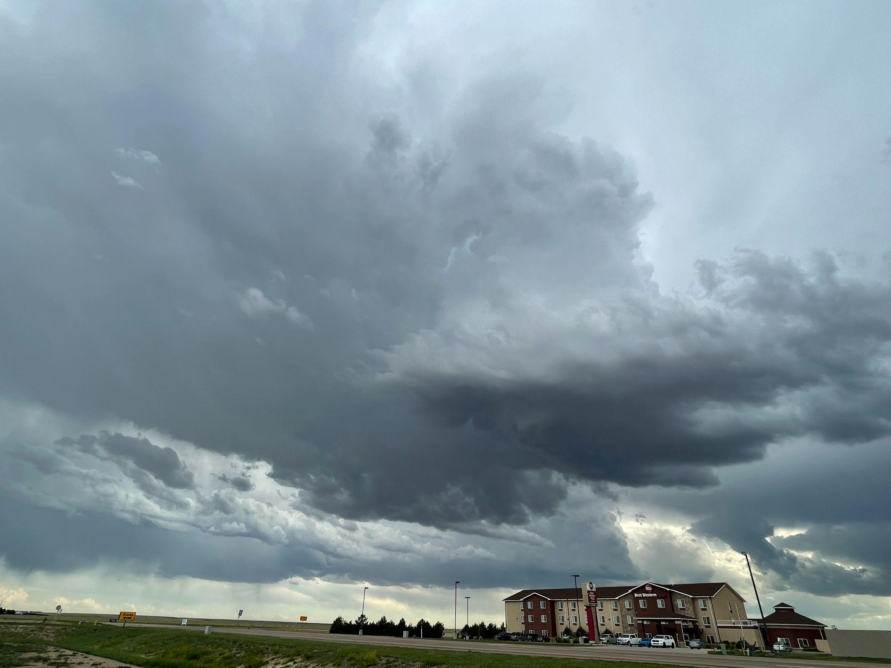
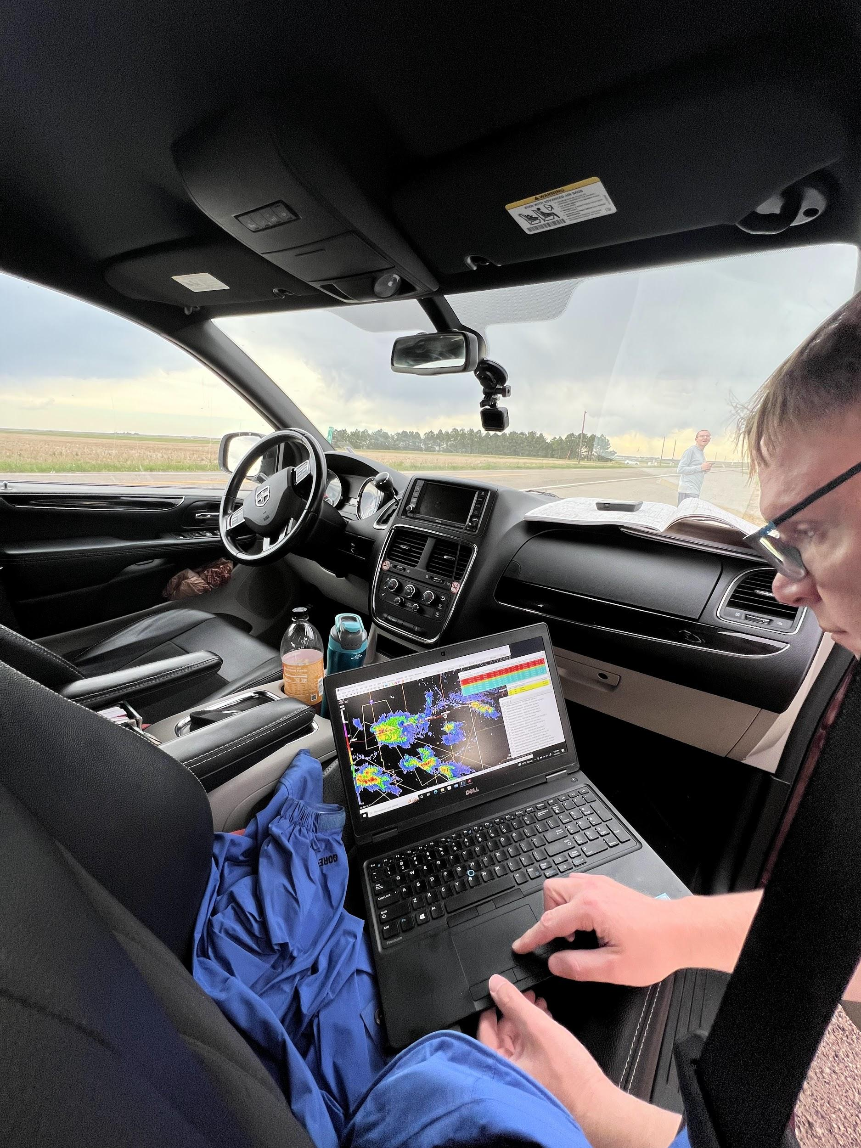
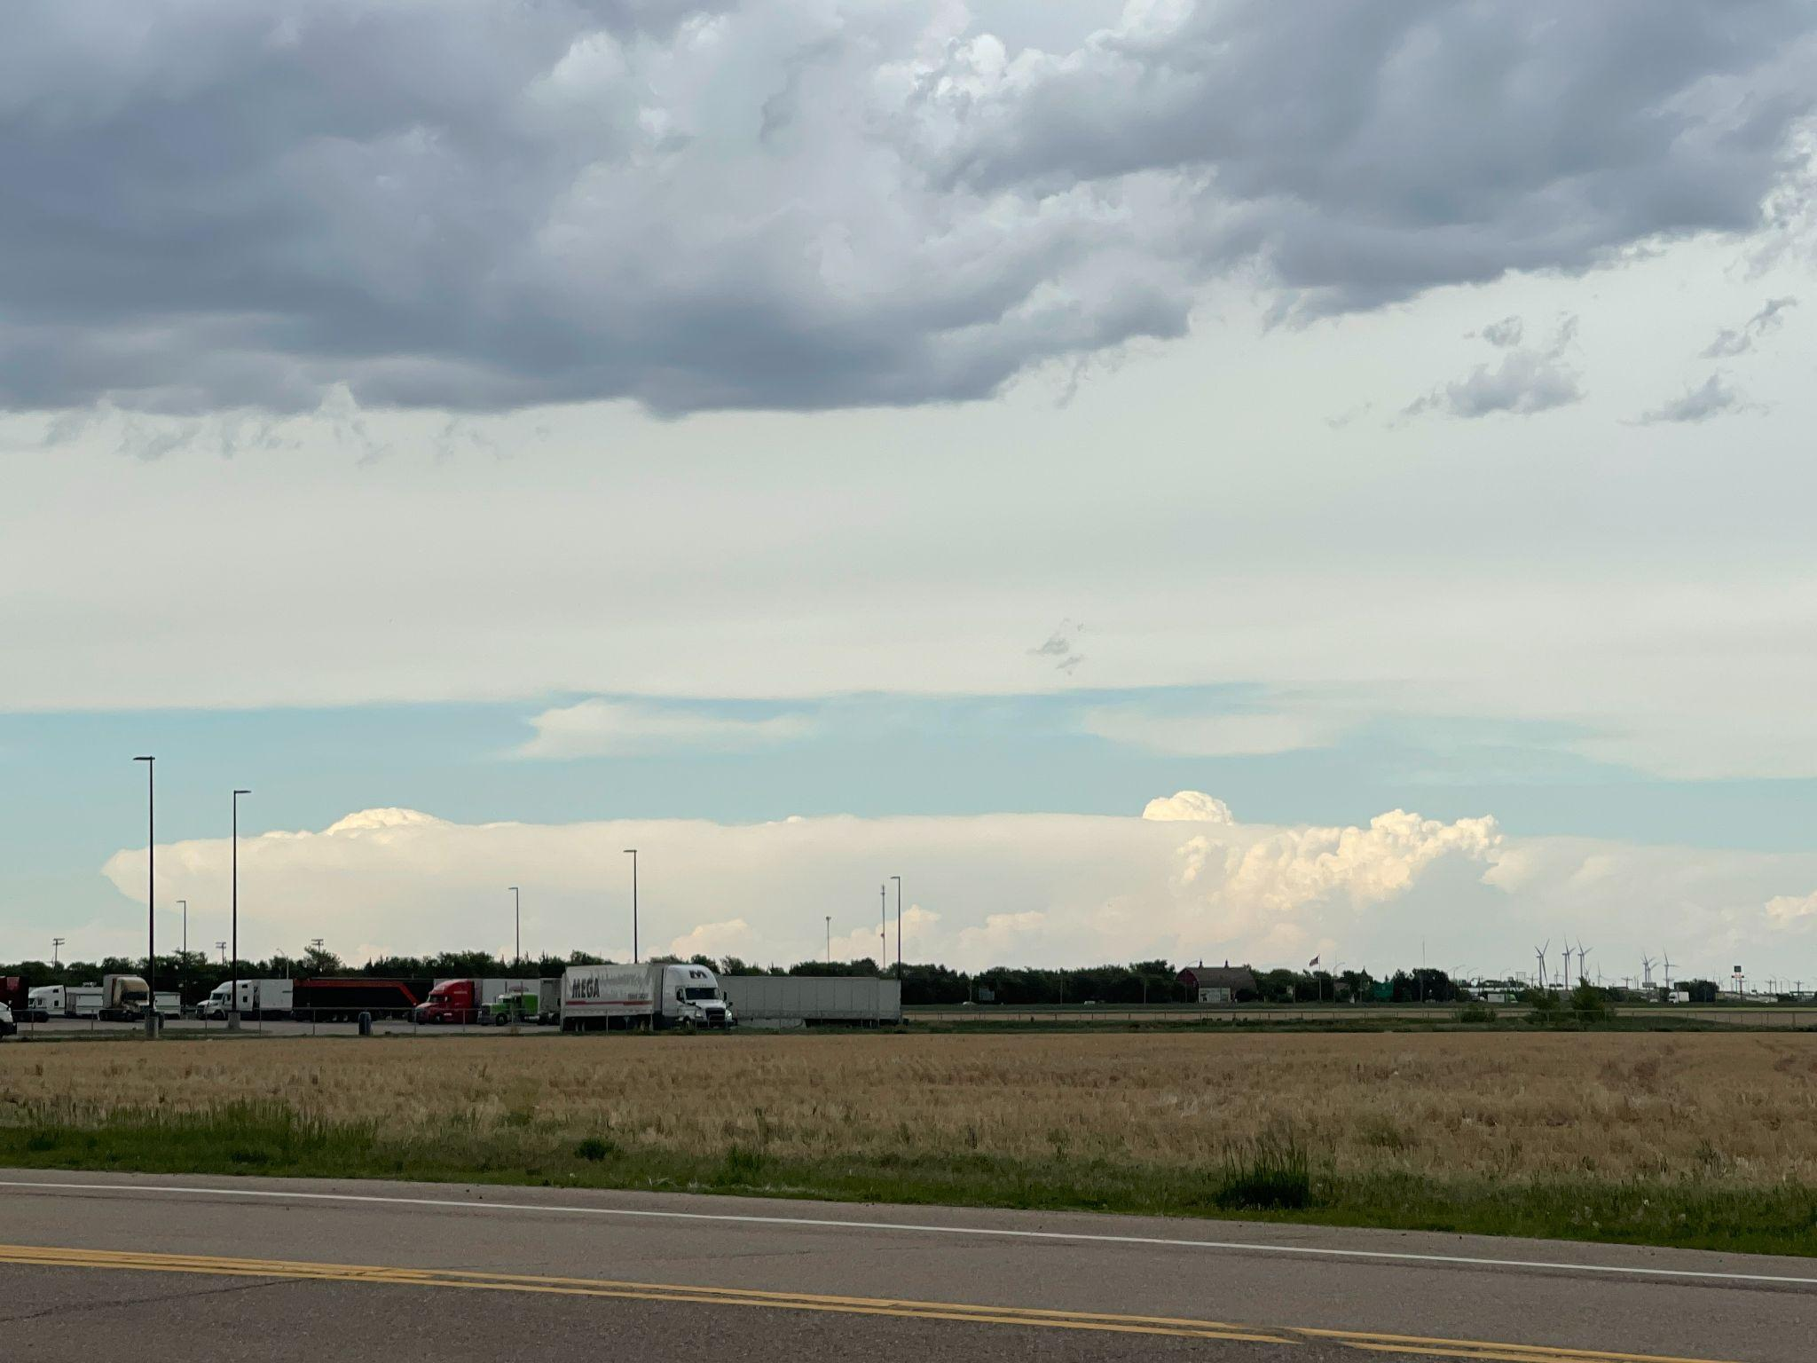
We were presented with two options…
What did we choose?
OR
Follow the storms and wall cloud that developed from the Burlington, CO storm?
Chase this established supercell to our northeast, dropping into Kansas?
Notes:
Jeremy

Slide 22
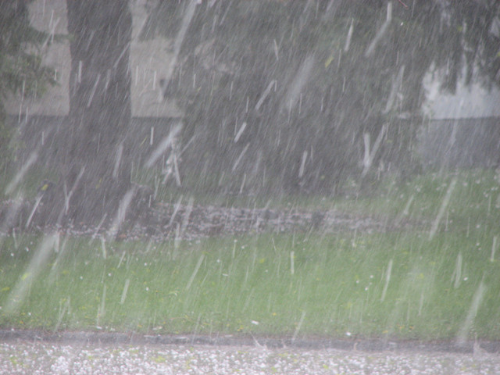
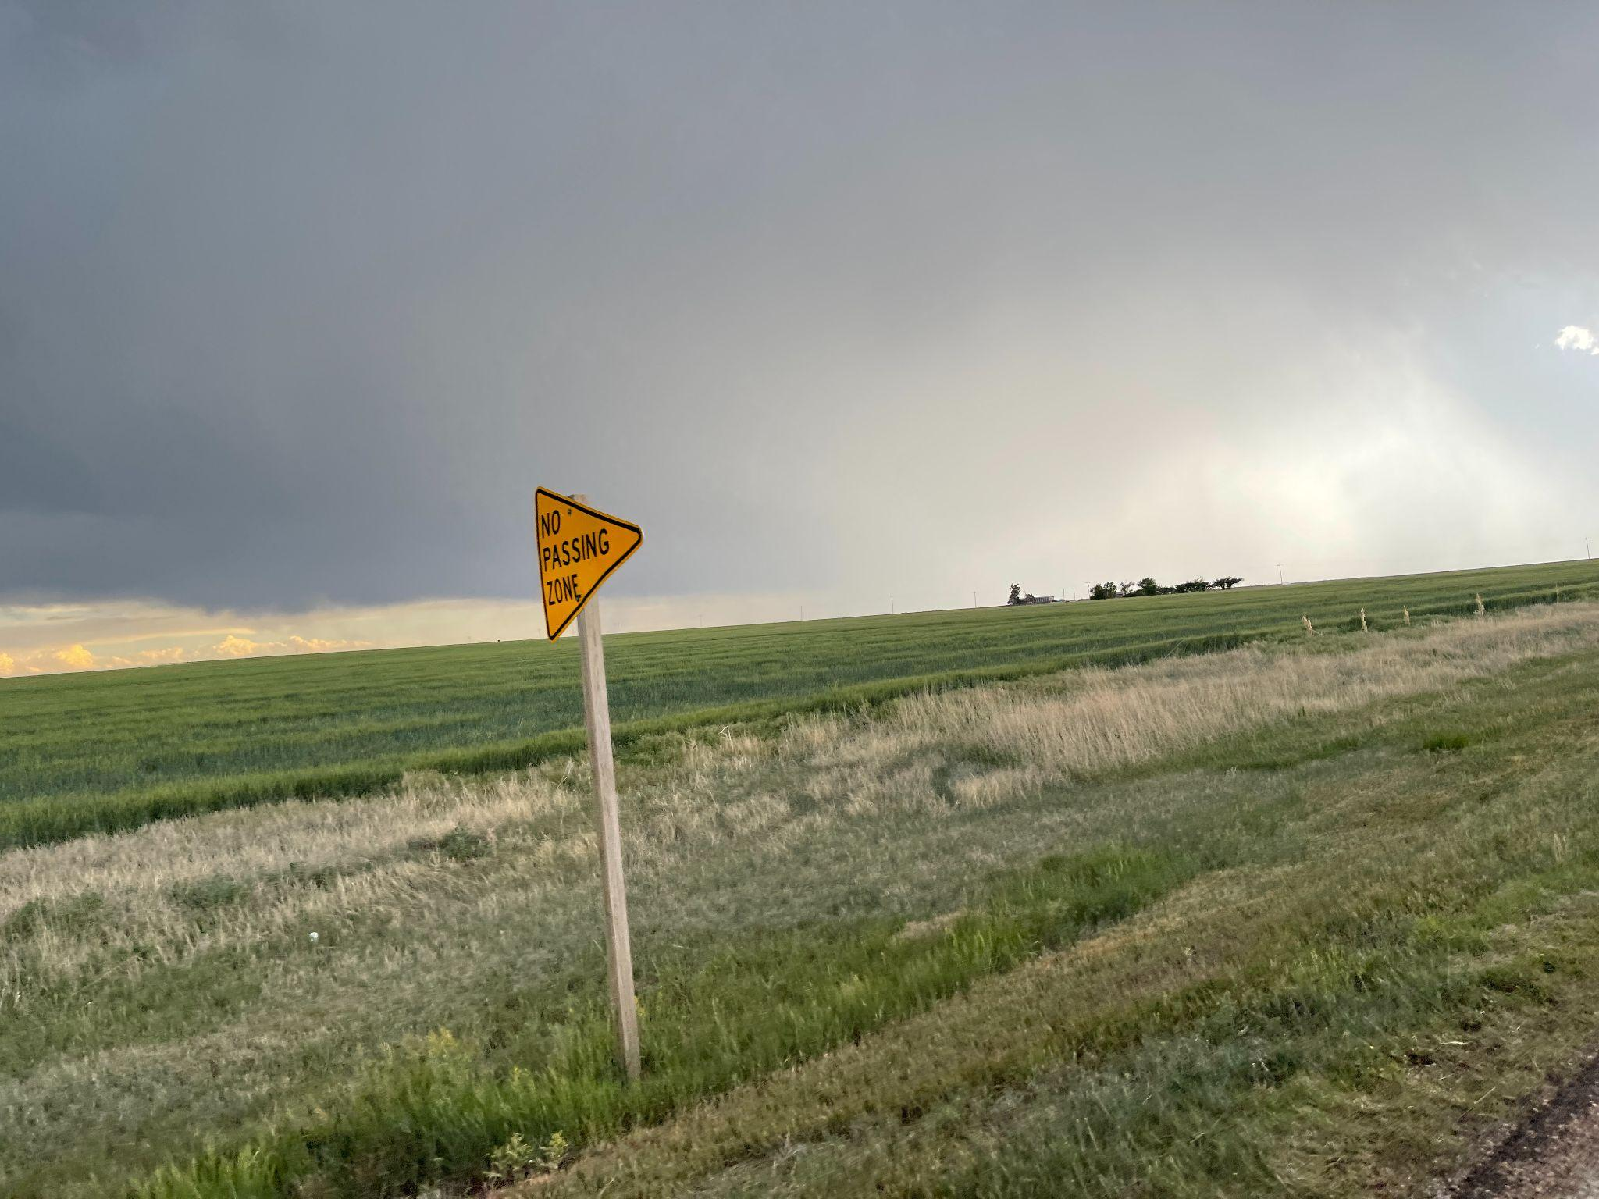
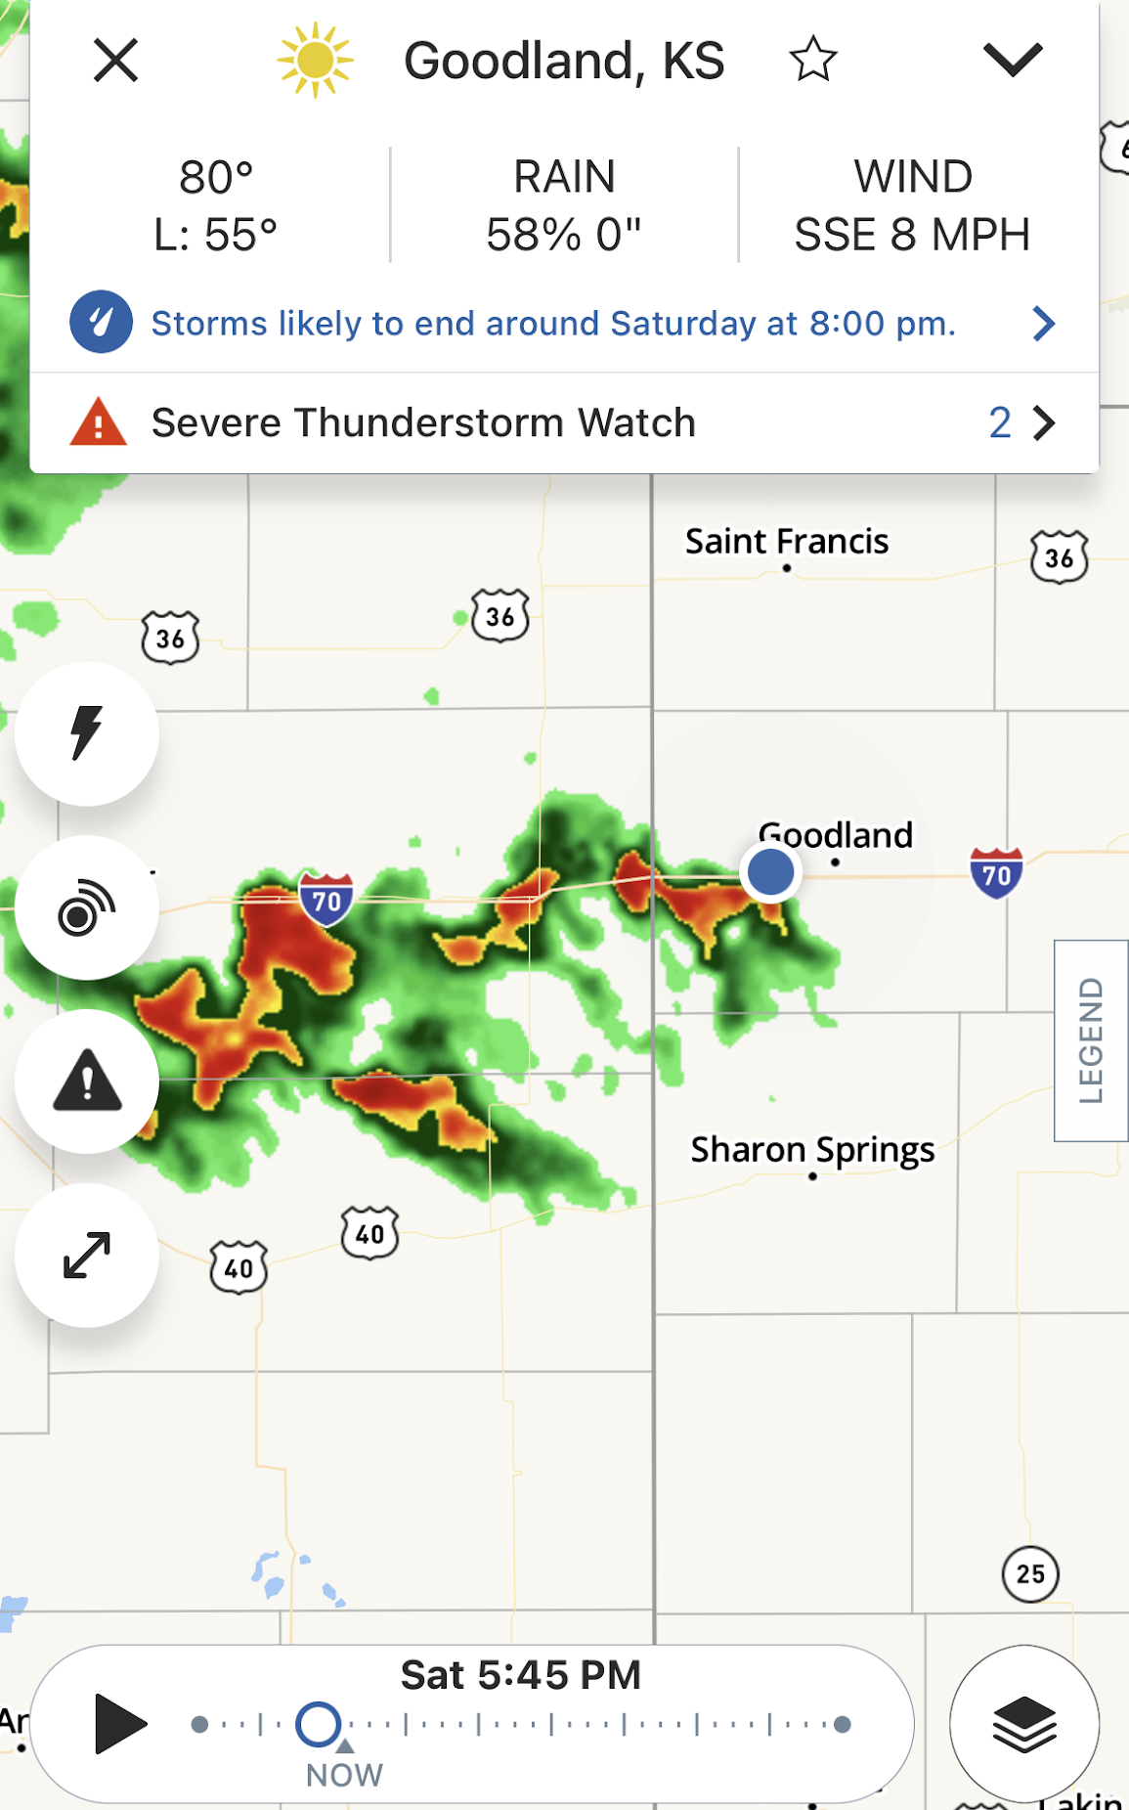
Caught in a hailstorm!
Stay away from white- or green-looking precip!
The Colorado storm weakened, so choosing to chase the supercell ended up being the right call!
**Remember these storms….they will affect our night later on!**
Notes:
Charles

Slide 23
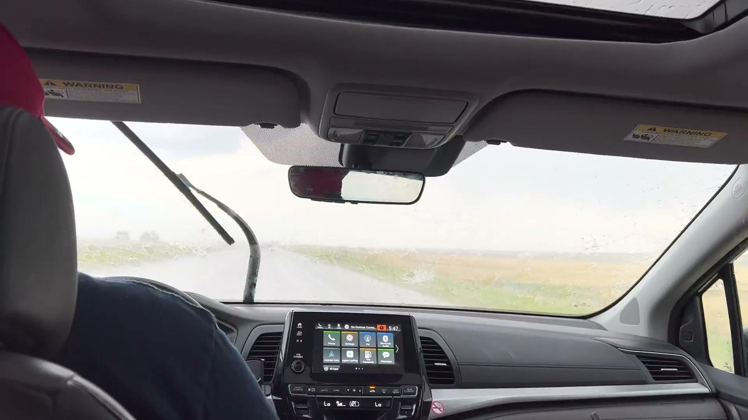
Notes:
Jeremy

Slide 24
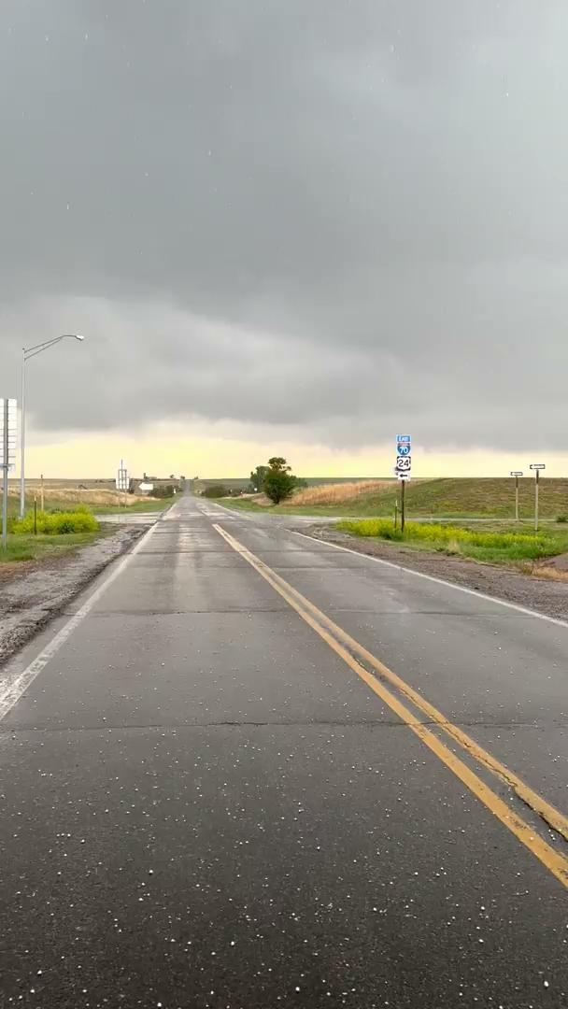
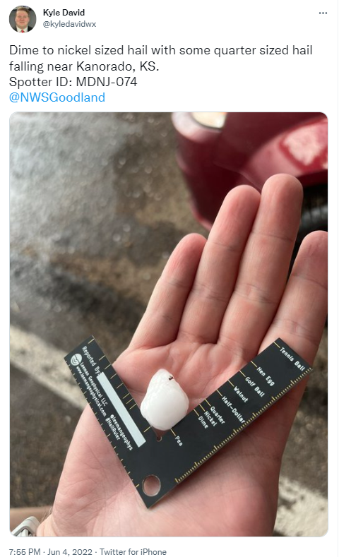
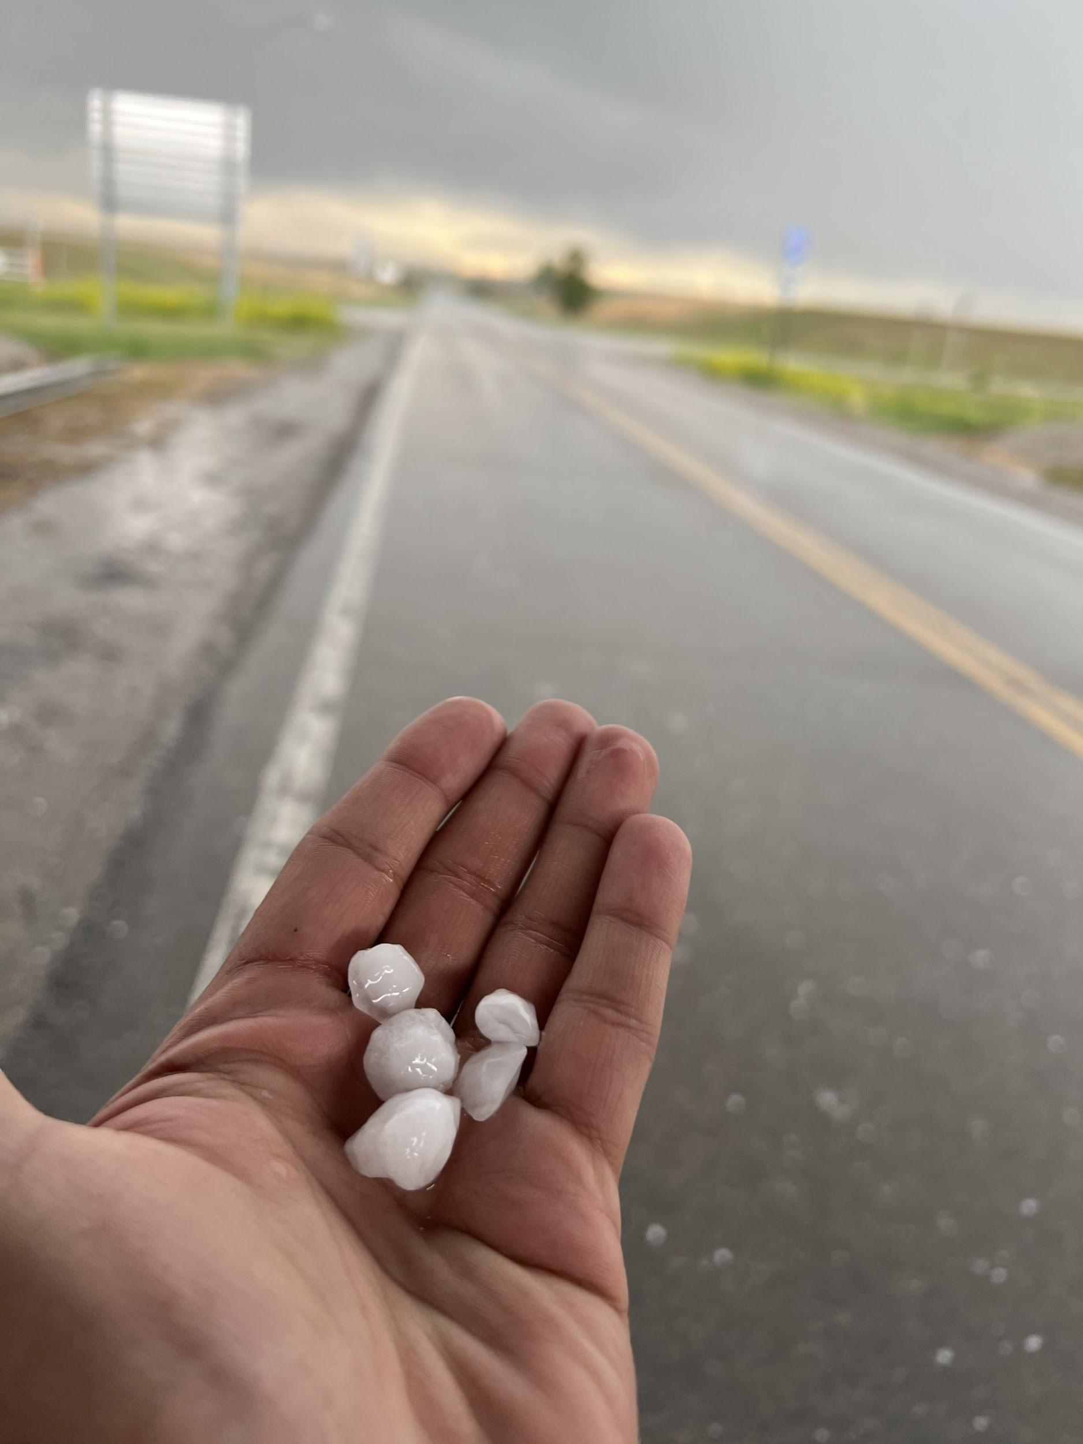
Notes:
Jeremy

Slide 25
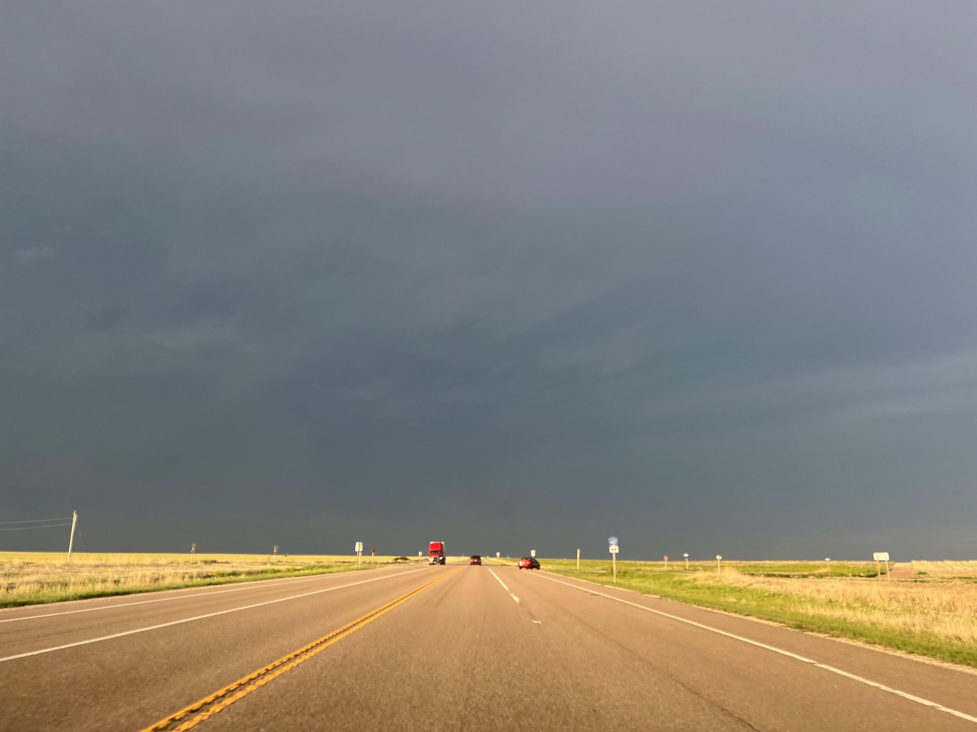
Heading toward the Infamous Oberlin
Notes:
Kyle

Slide 26
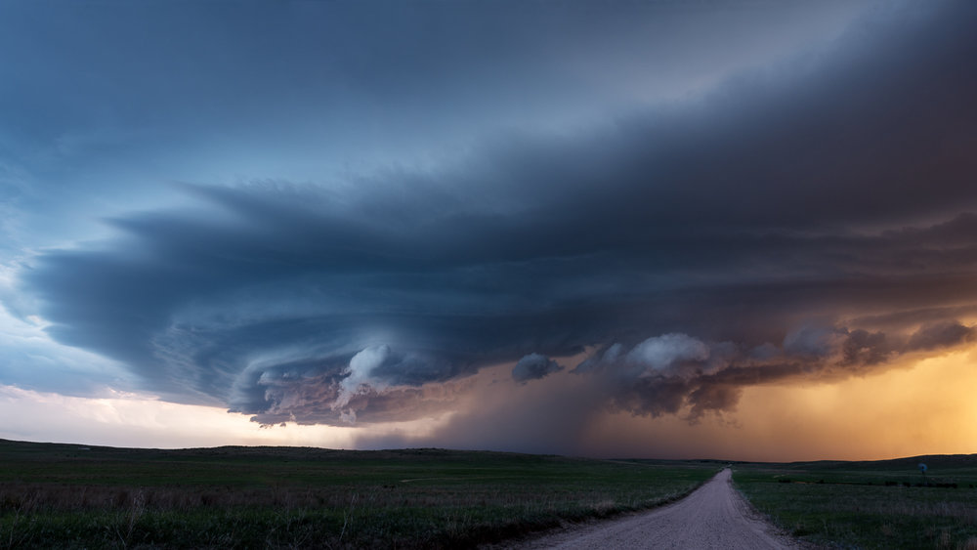
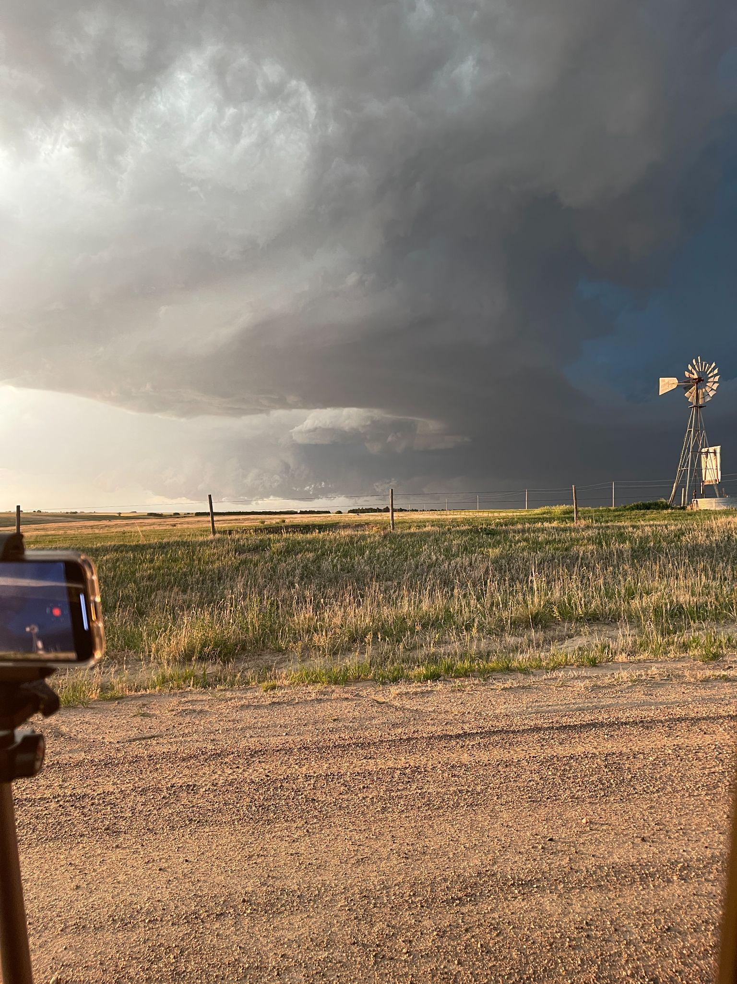
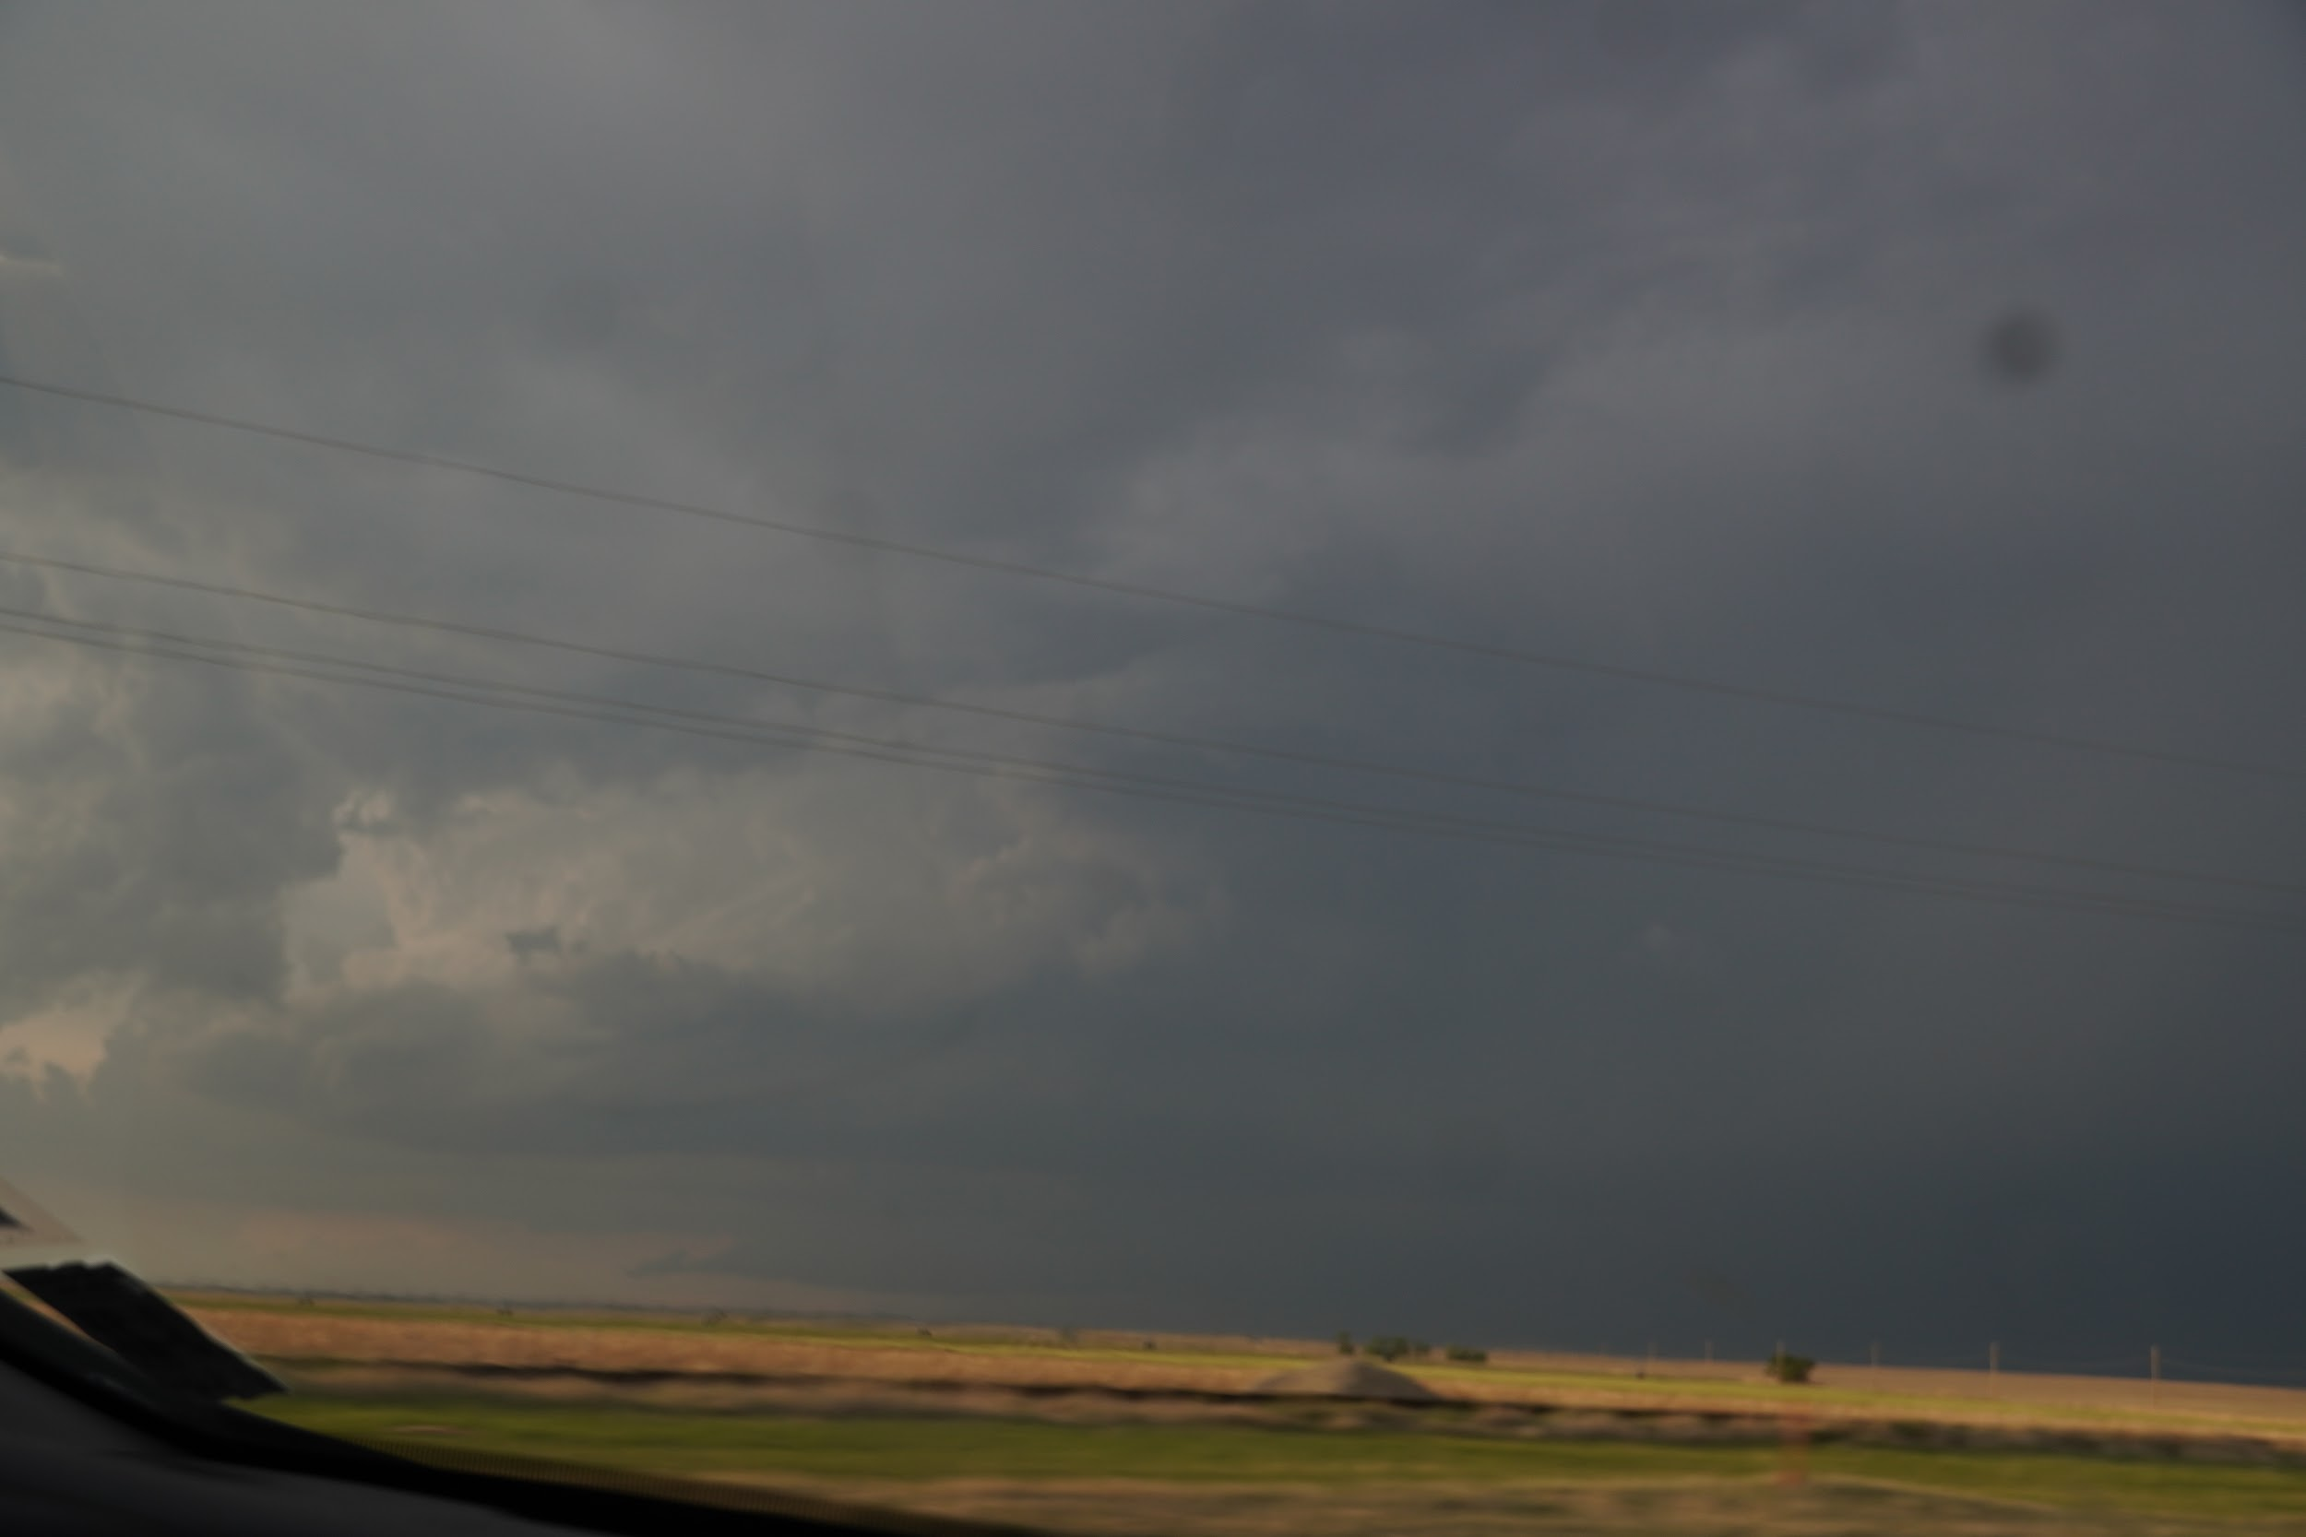
Watching the storm approach us!
Closer up!
The first time we had visual on the updraft it put into perspective just how large the storm was. You can see it at the base of the cloud!
This is hail!
Notes:
Charles

Slide 27
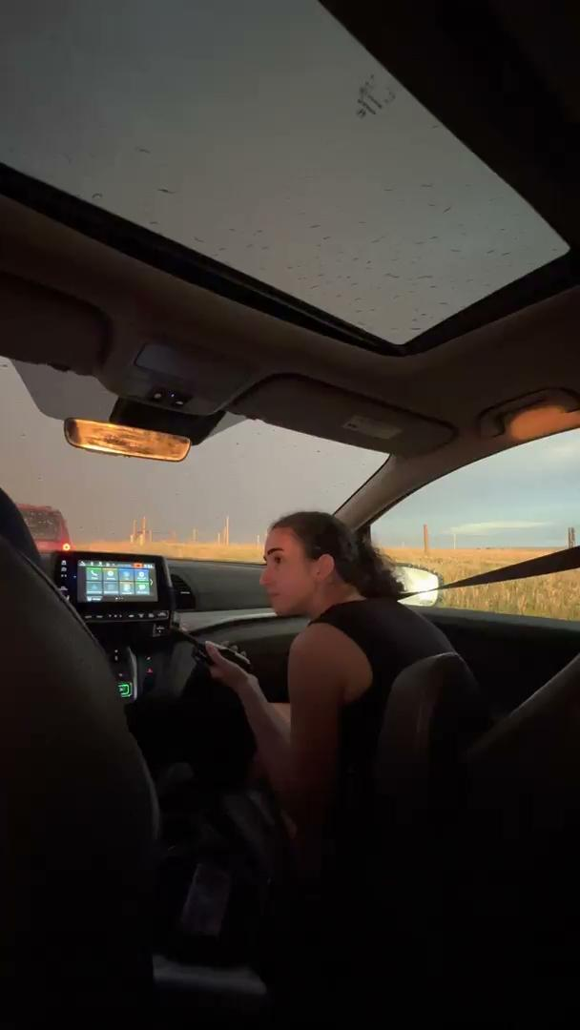
Notes:
Jeremy

Slide 28
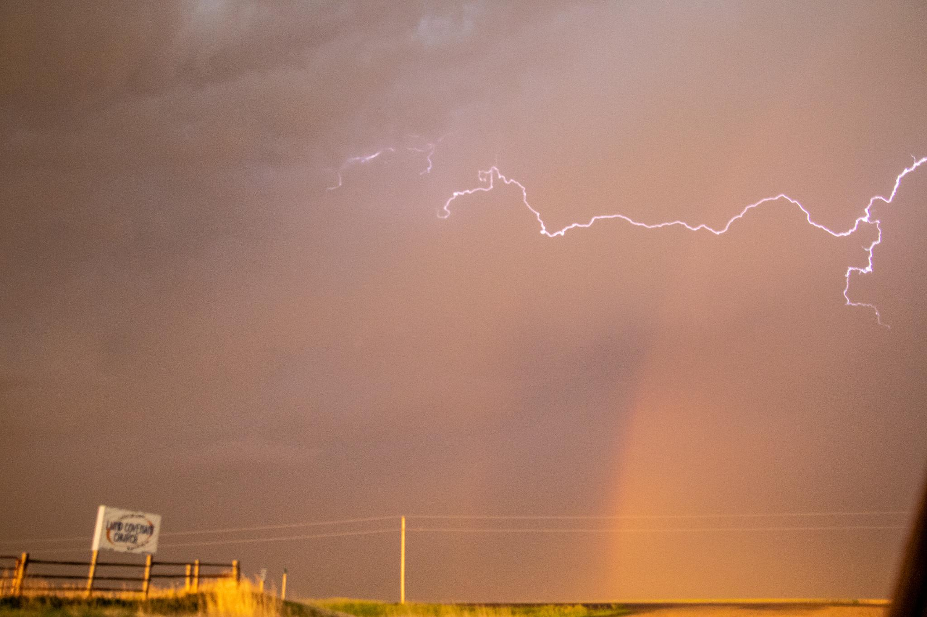

Slide 29
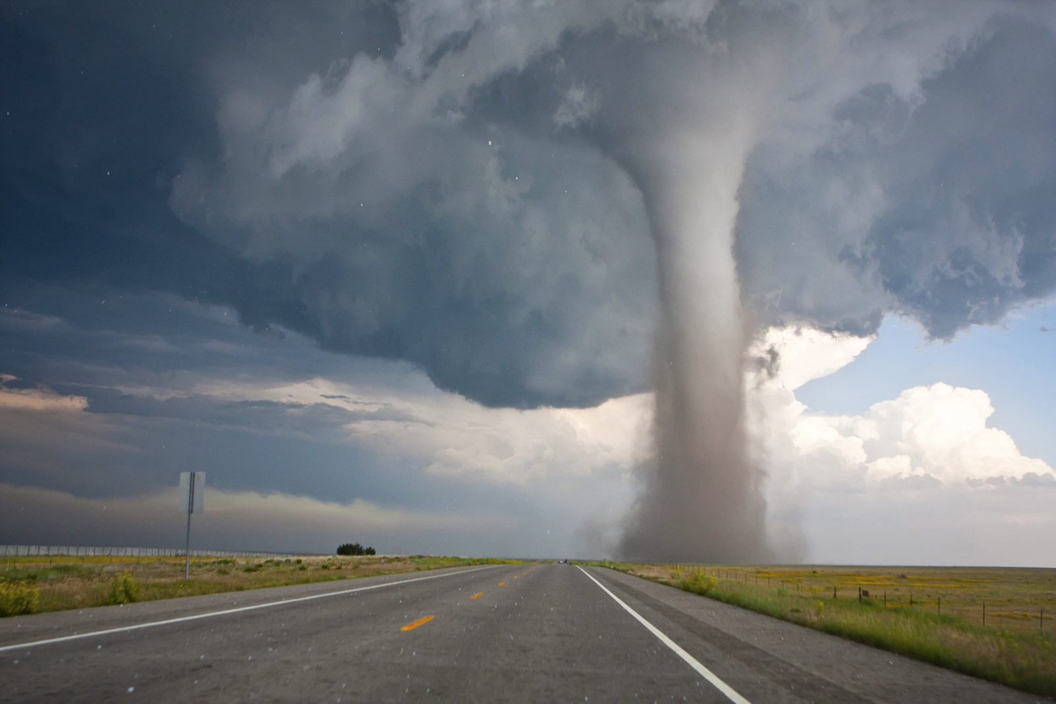
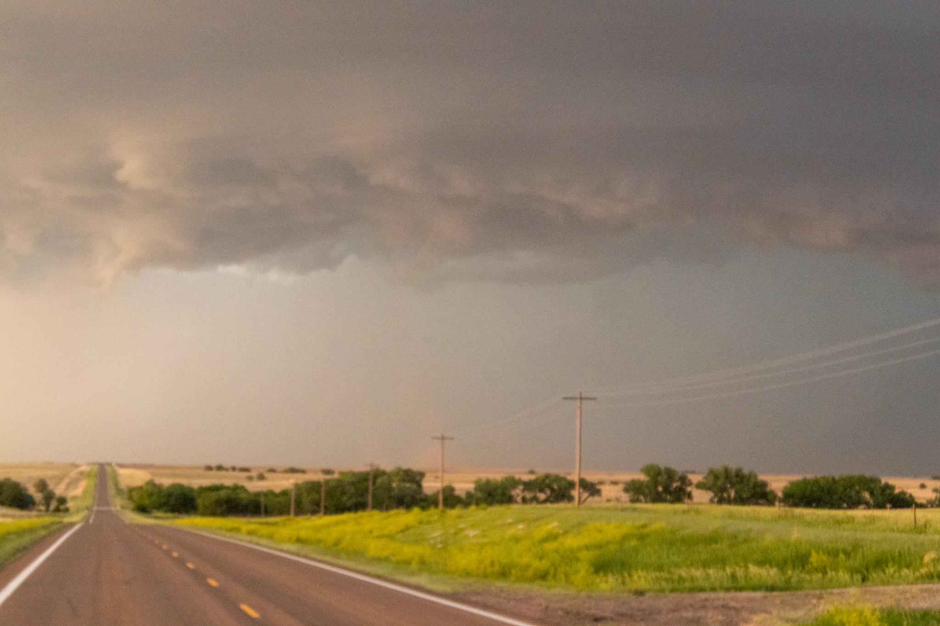
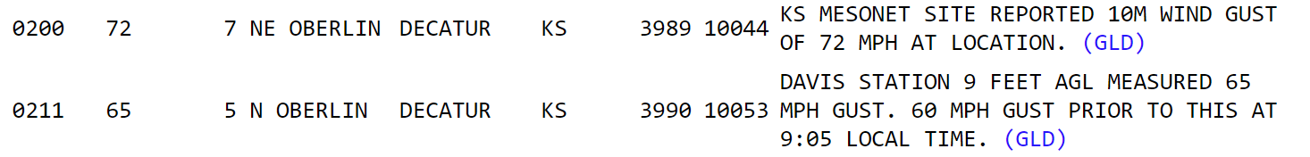
Then, we saw a tornado!
At 8:01 CDT, we saw the landspout tornado!
Funnel Cloud
Dust Cloud
Notes:
Kyle

Slide 30
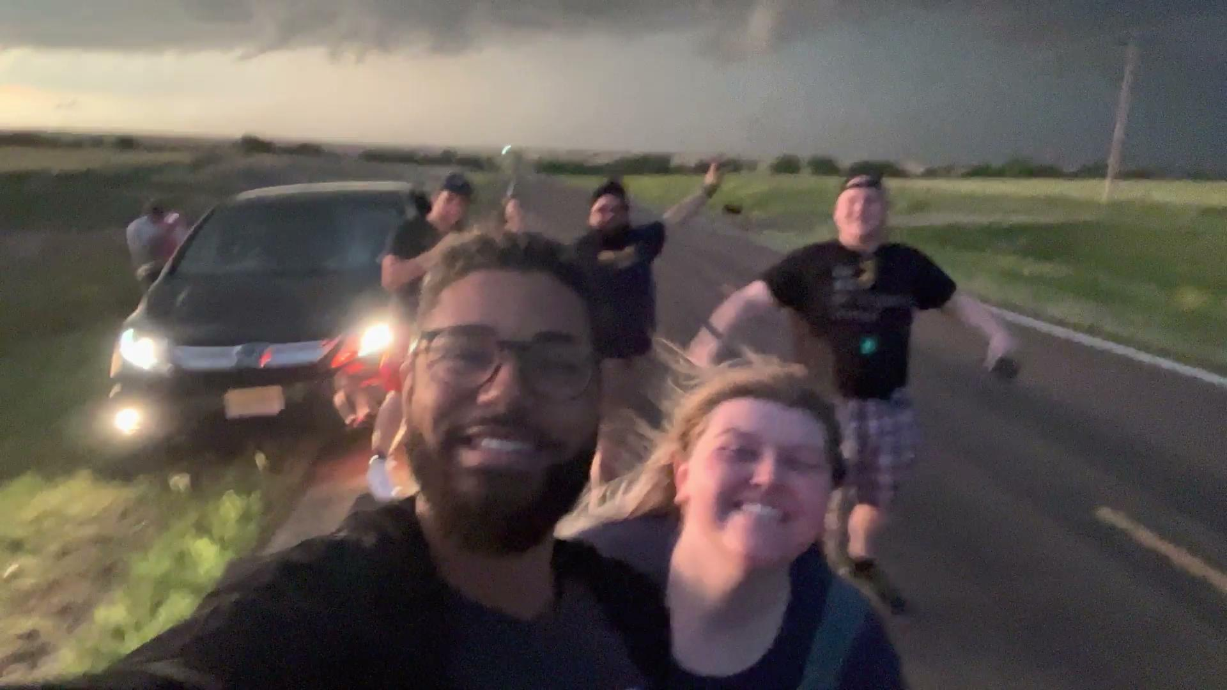
Notes:
Jeremy

Slide 31

A Better View of the Tornado From the North
Courtesy of Storm Chaser Kyle Cuttler
via Twitter
Notes:
Kyle

Slide 32


This tornado was Anticyclonic!
Movement Away From The Radar
Movement Towards The Radar
Notes:
Kyle

Slide 33

Anticyclonic and why it’s uncommon!
Winds in a tornado in the N. Hemisphere usually rotate counterclockwise due to several factors:
Coriolis Force (the rotation of the Earth)
Warm air advection & increasing instability cause veering (counterclockwise turn) of winds with height
Movement Away From The Radar
Movement Towards The Radar
Typical flow of winds around a low-pressure zone (which can include tornadoes)
Notes:
Kyle

Slide 34

On the way back…
Interestingly, the gust fronts from the Colorado storms created a storm west of the Oberlin Cell!
Lightning!!!
Notes:
Charles

Slide 35

On the way back…
More Lightning!!!
Notes:
Kyle

Slide 36


TVSs
Showing the radar!
Notes:
Kyle

Slide 37

Hail size indicated on WCT-viewer
2.5”
1”
1”
Notes:
Kyle

Slide 38



Notes:
Jeremy

